Slide 1
Transforming Energy through American Innovation
Nicholas Hamiton
Wind Enery Seminar
10 February 2021x
Notes:
Picture: 61725, South Table Mountain Campus (Photo by Joshua Bauer / NREL)

Slide 2
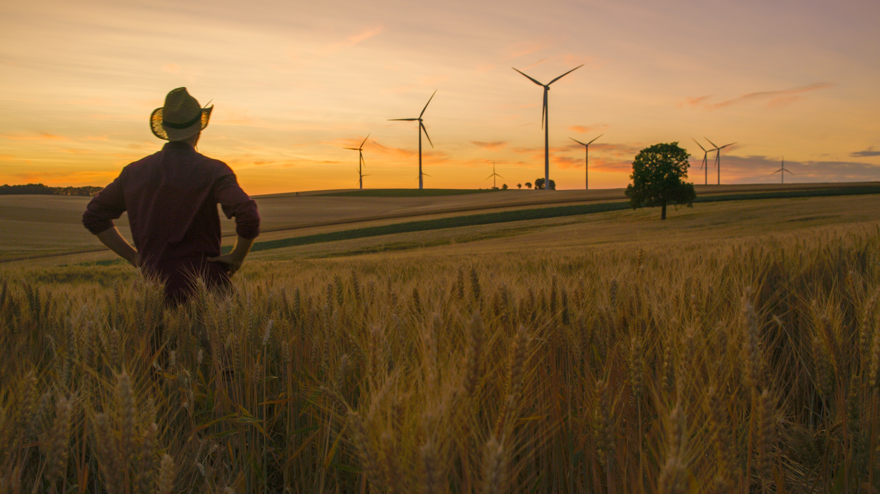
An Energy Revolution
Is Sweeping the Nation
Notes:
Picture: iStock 1216403193
An energy revolution is sweeping across the nation, creating American jobs, boosting economic growth, spurring innovation, and strengthening U.S. energy security.
NREL is a key component of this revolution.
NREL started in 1977 as the Solar Energy Research Institute (SERI). It was created out of national concern during the 1973 oil embargo and in response to the Solar Energy Research, Development, and Demonstration Act of 1974. NREL was created to research technologies that would strengthen the United States’ efforts toward gaining energy independence.
President Jimmy Carter visited SERI in 1978, and in 1979 said, famously, “No one can ever embargo the sun or interrupt its delivery to us.”
In 1991, President George H.W. Bush elevated SERI to a U.S. Department of Energy national laboratory and changed its name to the National Renewable Energy Laboratory (NREL).

Slide 3

Creating American Jobs
in Advanced Energy
Notes:
Picture: iStock 813968046
According to the United States Department of Energy’s (DOE) U. S. Energy and Employment Report, nearly 6.7 million Americans, or nearly 5 percent of the U. S. workforce were employed in the traditional energy and energy efficiency sectors in 2018.
Employment in these sectors increased in 2018 by 2.3 percent from the previous year, adding 151,700 net new jobs, nearly 7 percent of all new jobs nationwide.
As our nation’s energy system changes, hundreds of thousands of new domestic jobs are being created.
NREL’s advanced scientific research is making significant contributions to our nation’s energy transformation.
For example, NREL researchers are at the forefront of cadmium telluride thin-film (CdTe) solar R&D. Our CdTe and copper indium gallium diselenide (CIGS) semiconductors resulted in more than 100 publications and 10 U.S. patents.
Our NREL partner, First Solar, commercialized this technology and is now the global manufacturing leader of it with 6,400 employees and annual revenues of $2.4 billion.
In addition, after NREL pioneered advances in wind turbine blade design and control systems, General Electric adopted these innovations and now dominates the U.S. market. GE continues to leverage NREL simulation tools to boost wind plant production—while serving as a workforce development resource for the booming U.S. manufacturing industry.
Sources
U.S. Department of Energy, 2019 U.S. Energy and Employment Report (available here: https://www.usenergyjobs.org/2019-report)

Slide 4
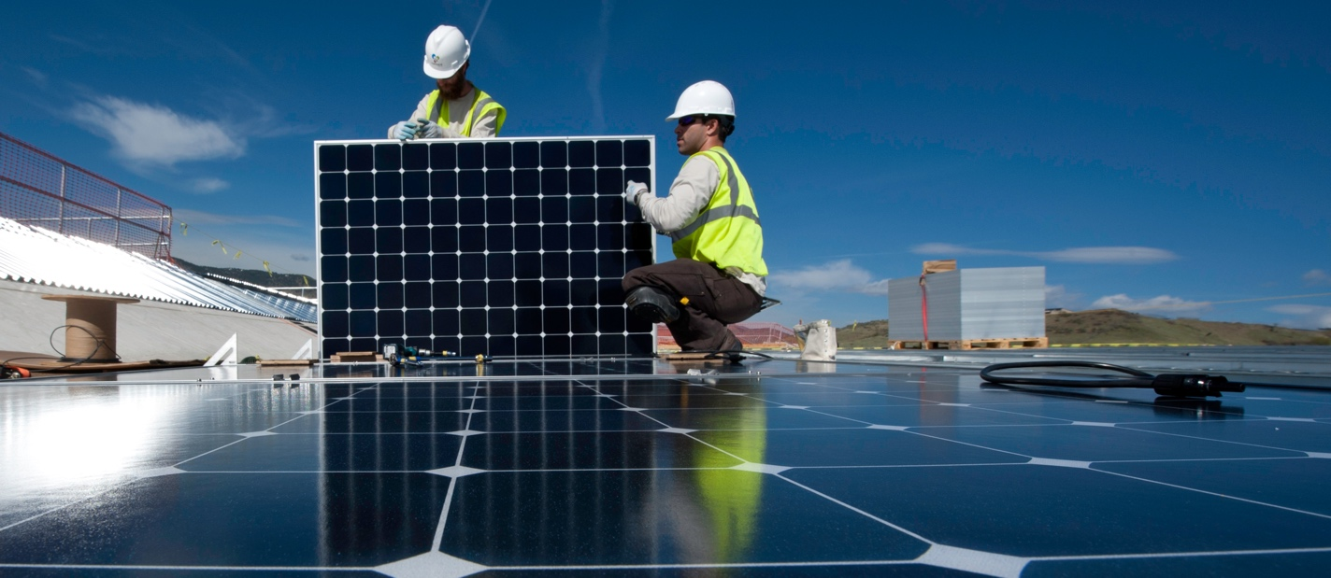
Solar and Wind Fueling U.S. Energy Job Growth
New Energy Jobs 2019
About 6.8 million Americans are employed in the energy and energy efficiency sectors in the United States.
Solar, natural gas, and wind generation were the fastest growing new energy sources across the country.
In 2019, the electric power generation sector grew at a rate of about 2.5% and employed 896,000 people. The approximately 21,200 jobs were predominantly in solar, wind, natural gas, hydro, combined heat and power, and geothermal.
Solar energy firms employed 248,000 Americans who spent the majority of their time on solar work and an additional 97, 400 employees who spent less then 50% of their time on solar work.
Wind energy is growing too. Employment in wind energy was up 3.2% in 2019 for a total of 114,800 employees across the country.
Source: 2020 U.S. Energy & Employment Report
Notes:
Picture: 21488, 4/18/2012, Parking Garage at NREL, (Photo by Dennis Schroeder / NREL)

Slide 5
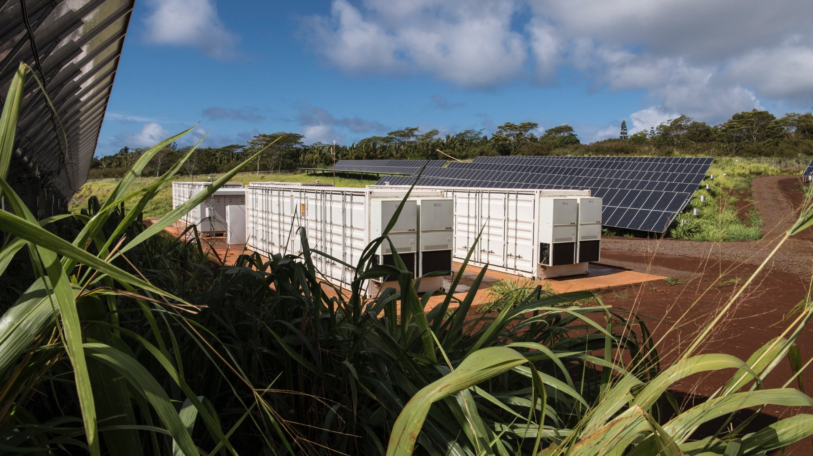
Transforming the
Energy Supply in the United States
Notes:
Picture: 58023, 6/18/2019, AES Lawai Solar Project- Kauai (Photo by Dennis Schroeder / NREL)
Now I want to provide you with a little more background on the rapid changes to the energy supply that are currently underway in the United States.

Slide 6
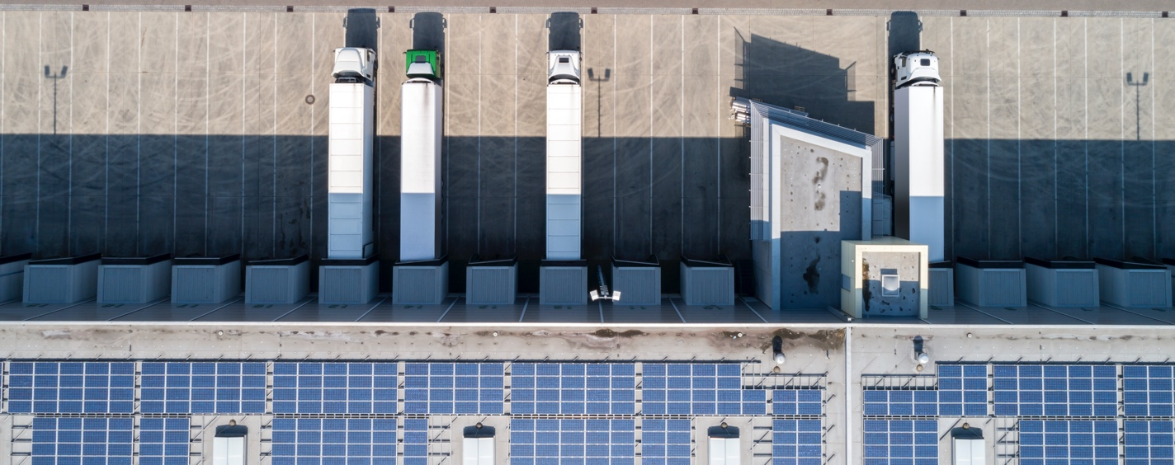
Energy Productivity
in the United States
U.S. GDP and primary energy consumption
Indexed to 1990 levels
U.S. energy productivity
$ trillion of GDP / quadrillion BTU of energy
2.2
0.20
2.0
0.18
Energy productivity
1.8
GDP (index)
0.16
Since 1990, the U.S. economy has nearly doubled as measured in gross domestic product (GDP), but primary energy consumption has increased only 19%. This represents a 72% improvement in U.S. energy productivity.
1.6
1.4
0.14
1.2
0.12
1.0
Primary energy consumption (indexed)
0.10
0.8
0.8
1990
1995
2000
2005
2010
2015
2019
1990
1995
2000
2005
2010
2015
2019
Source: 2019 Sustainable Energy in America Factbook, Bloomberg New Energy Finance and the Business Council for Sustainable Energy, February 2019
Notes:
Picture: iStock-1138700236.jpg
The U. S. economy expanded by 2.9% in 2018, which was the fastest growth since 2005 with the exception of one year. Primary U. S. energy consumption grew by 3.3% marking the first time it has outpaced GDP expansion since 2013.
The year-on-year growth in primary energy consumption can be attributed to a combination of faster economic growth and weather conditions.
Since 1990, the U. S. economy has nearly doubled as measured in GDP, while primary energy consumption has increased only 20%. This represents a 66% improvement in U. S. energy productivity.
Source: 2019 Sustainable Energy in America Factbook, Bloomberg New Energy Finance and the Business Council for Sustainable Energy, February 2019

Slide 7
Cost for Renewables are Falling
Advanced energy technologies are providing real-world solutions by:
Becoming increasingly cost-competitive
Boosting the U.S. energy industry
Providing jobs for American workers
2019 Xcel pricing for projects due to go online in 2023
Source: Lazard’s 2019 Levelized Cost of Energy Analysis
Notes:
Source: Lazard estimates.

Slide 8
U.S. Electric Generation by Energy Source (2010-2020)
Share of Generation
U.S. Energy Supply is Shifting
Forecast
50%
45%
40%
Natural Gas
35%
30%
25%
Coal
20%
Nuclear
15%
Non-Hydro Renewables
Renewable energy—not including hydropower—currently produces 10% of the total U.S. electricity generation. Within the next two years, this is expected to grow to 13%.
10%
Hydropower
5%
0%
Other
2010
2012
2014
2016
2018
2020
Source: United States Energy Information Agency, Today in Energy, 18 January 2019

Slide 9
U.S. Annual Renewable Generation, by Fuel Type
Million Megawatt-hours
800
Renewables Have Doubled in the United States Since 2008
700
Solar
600
500
Wind
400
300
200
Hydro
100
Other Renewables
0
2008
2009
2010
2011
2012
2013
2014
2015
2016
2017
2018
U.S. Annual Net Generation, Wind
Million Megawatt-hours
U.S. Annual Net Generation, Solar
Million Megawatt-hours
300
300
250
250
200
200
Renewable generation provided a new record of 742 million megawatt-hours (MWh) of electricity in 2018, nearly double the 382 million megawatt-hours produced in 2008.
150
150
100
100
50
50
0
0
2008
2010
2012
2014
2016
2018
2008
2010
2012
2014
2016
2018
Source: United States Energy Information Administration, Today in Energy, March 19, 2019
Notes:
Renewable generation provided a new record of 742 million megawatthours (MWh) of electricity in 2018, nearly double the 382 millionMWh produced in 2008.
Renewables provided 17.6% of electricity generation in the United States in 2018.
Nearly 90% of the increase in U.S. renewable electricity between 2008 and 2018 came from wind and solar generation. Wind generation rose from 55 million MWh in 2008 to 275 million MWh in 2018 (6.5% of total electricity generation), exceeded only by conventional hydroelectric at 292 million MWh (6.9% of total generation).
U.S. solar generation has increased from 2 million MWh in 2008 to 96 million MWh in 2018. Solar generation accounted for 2.3% ofelectricity generation in 2018. Solar generation is generally categorized as small-scale (customer-sited or rooftop) solar installations orutility-scale installations. In 2018, 69% of solar generation, or 67 million MWh, was utility-scale solar.
Charts right:
Increases in U. S. wind and solar generation are driven largely by capacity additions. In 2008, the United States had 25 gigawatts of wind generating capacity. By the end of 2018, 94 GW of wind generating capacity was operating on the electric grid.
Similarly, installed solar capacity grew from an estimated less that 1 GW in 2008 to 5.1 GW in 2018. 30 GW of this solar capacity was utility-scale solar photovoltaics (PV), 1.8 GW was solar thermal, and the remaining 20 GW was small-scale solar PV.
Source: Source: U.S. Energy Information Administration, “Today in Energy,” March 19, 2019

Slide 10
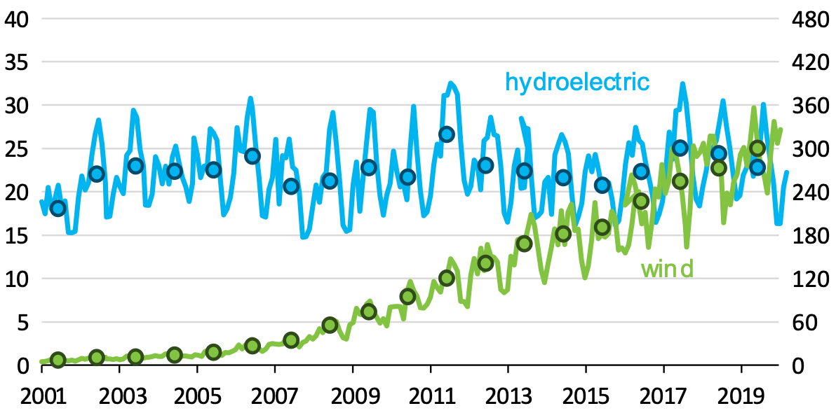
Wind Surpasses Hydro for U.S. Renewable Electricity Generation
2009 – 2019 Annual Electricity Generation from Wind and Hydro Sources
2001 – 2019 U.S. Electricity Generation from Wind and Hydro Sources
wind
hydroelectric
Million megawatt hours
Million megawatt hours
During the winter of 2019, wind became the top renewable source of electricity generation in the country, a position previously held by hydroelectricity.
Capacity growth has been the predominant driver
of annual changes in wind generation.
Source: United States Energy Information Agency, Today in Energy, February 26, 2020
Notes:
Source: eia Today in Energy, https://www.eia.gov/todayinenergy/detail.php?id=42955

Slide 11
U.S. electric generating capacity additions (2019)
Megawatts
Growing U.S. renewable energy generating capacity
natural gas
wind
solar
other
U.S. total
23,328
West
3,464
Northeast
South
10,326
West
Midwest
Northeast
4,413
South
Midwest
5,125
0
5,000
10,000
15,000
20,000
25,000
Source: EIA Today in Energy, April 21, 2020
U.S. energy overview: Renewable energy build by technology
Gigawatts
22
.9
Hydro
19
19
.5
18
.0
.4
16
.4
G
e
o
t
h
e
r
m
a
l
3
.5
1
4
12
.1
2018 was the second highest year on record for the installation of renewables and hydroelectric capacity with at a total of 19.5GW.
.7
1
1
1
.7
1
.1
1
1
.0
B
i
o
m
ass
.
b
i
o
g
7
as,
9
.5
.7
8
.9
w
aste
-
t
o
-
e
n
0
ergy
.4
7
6
.1
.0
2
.2
S
o
l
a
14
r
.1
0
10
.9
.0
6
.5
8
.5
8
.3
7
.
7
5
7
.5
.0
5
4
.2
.8
W
i
n
d
2
0
0
9
2
0
1
0
2
0
1
1
2
0
1
2
2
0
1
3
2
0
1
4
2
0
1
5
2
0
1
6
2
0
1
7
2
0
1
8
Source: 2019 Sustainable Energy in America Factbook, Bloomberg New Energy Finance and the Business Council for Sustainable Energy, February 2019
Notes:
Source: eia Today in Energy, https://www.eia.gov/todayinenergy/detail.php?id=43415

Slide 12
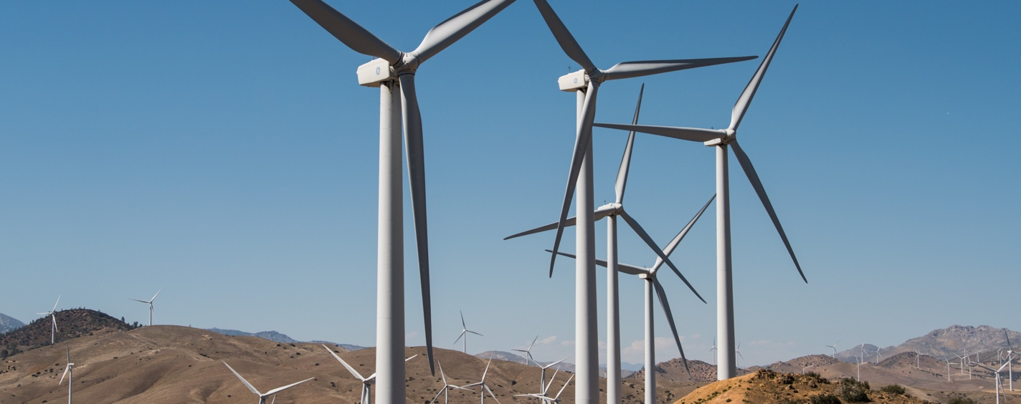
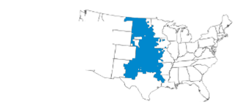
Central U.S. Sets New Power Records
Share of hourly electricity demand served by wind generation in Southwest Power Pool (April 24–May 3, 2020)
Gigawatts
Monday, April 27, 2020 hour ending 2 a.m. 72% new hourly record
Southwest Power Pool
35
30
25
Early in 2020, the Southwest Power Pool, which manages much of the electric grid for the central United States, set records for the highest share of electricity supplied by wind.
As a matter of fact on March 7, 2020, electricity supplied by wind generation reached 62%.
20
all other sources
15
10
5
wind
0
4/24
4/25
4/26
4/27
4/28
4/29
4/30
5/1
5/2
5/3
Source: United States Information Agency, Today in Energy, June 12, 2020
Notes:
Picture: 50709, Date: 4/30/2018, 100% Renewable Energy Study, (Photo by Dennis Schroeder / NREL)
Source: eia Today in Energy, https://www.eia.gov/todayinenergy/detail.php?id=44075

Slide 13
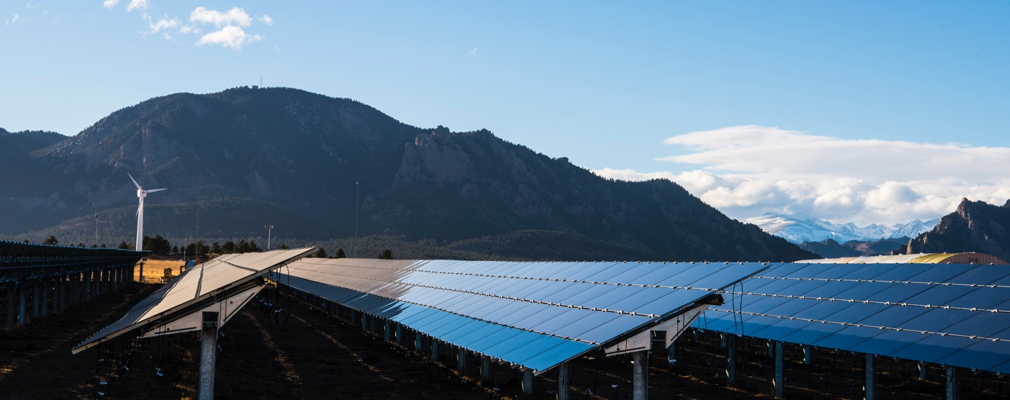
U.S. Energy Production Exceeded Consumption
U.S. total energy production and consumption (1950-2019)
Quadrillion British thermal units (quads)
120
consumption
101.0 quads
100
100.2 quads
80
In 2019, for the first time in 62 years, energy production in the U.S. exceeded consumption.
production
60
40
20
0
1950
1960
1970
1980
1990
2000
2010
Source: United States Information Agency, Today in Energy, April 28, 2020
Notes:
Picture: 55202 2/20/2019, First Solar (Photo by Dennis Schroeder / NREL)
Source: eia Today in Energy, https://www.eia.gov/todayinenergy/detail.php?id=43515

Slide 14
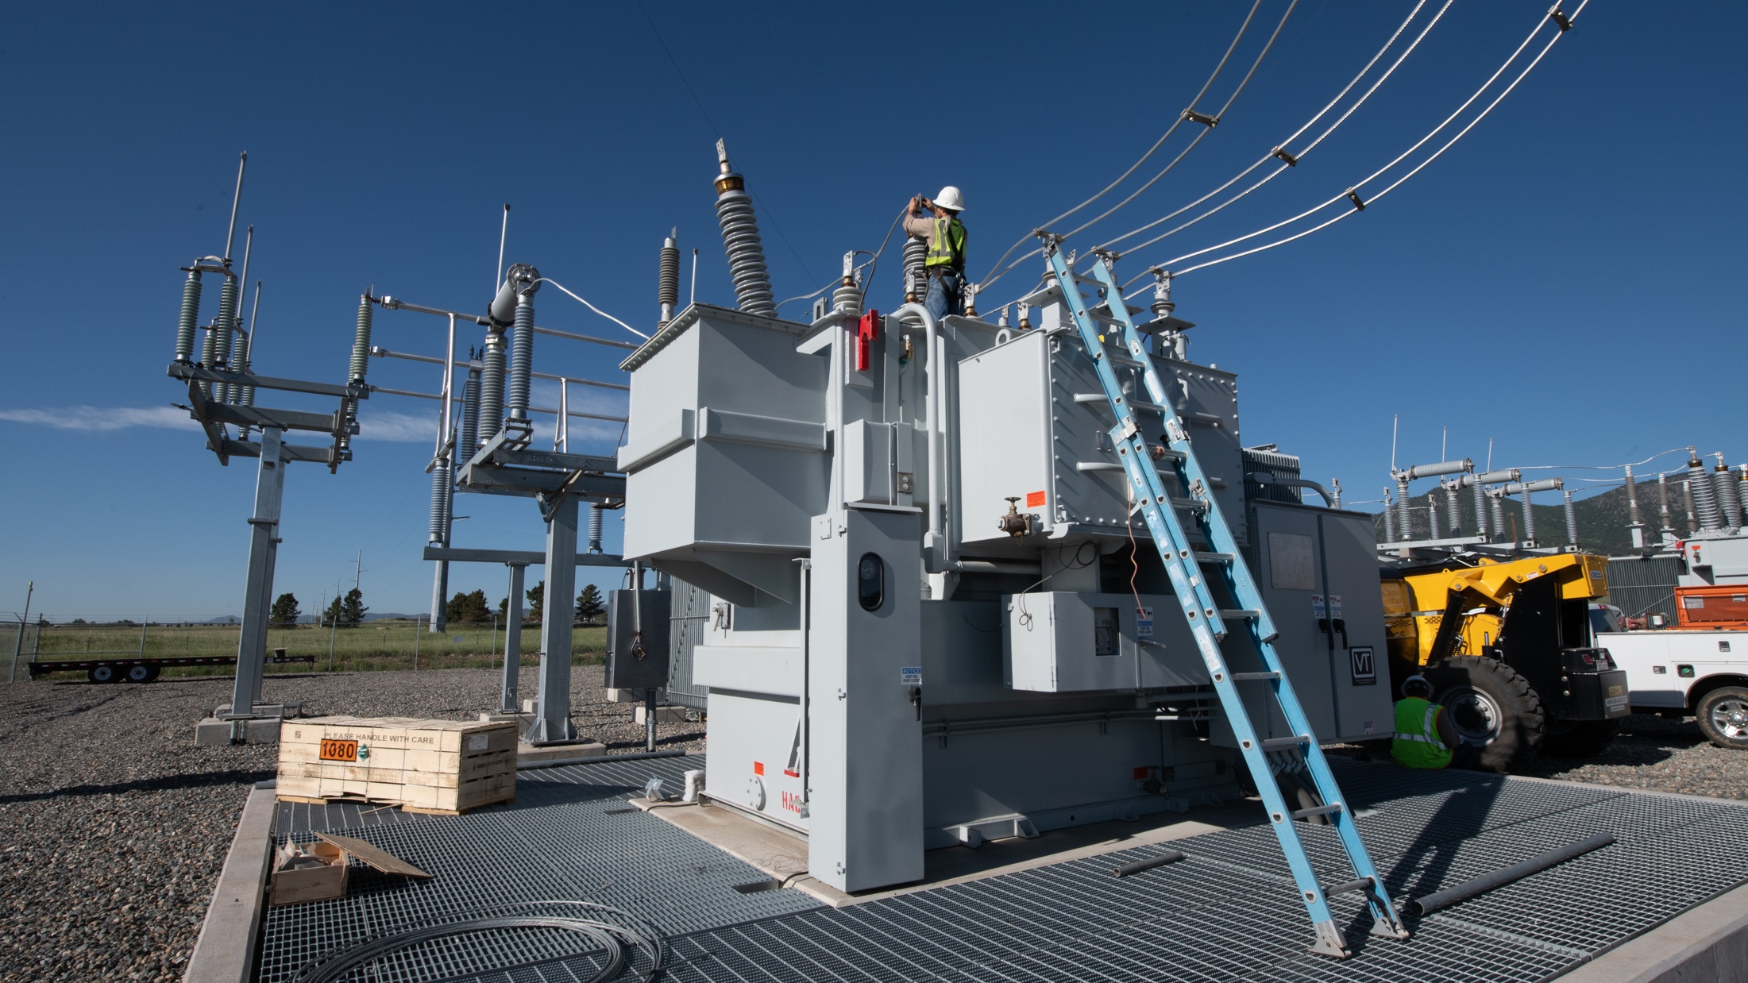
Creating a Safer America
Through Energy Security
Notes:
Picture: 61981, 6/3/2020, Flatirons Campus, (Photo by Dennis Schroeder / NREL)
At NREL, we are engaged in advanced scientific research to identify, detect, protect against and respond to the most significant threats to our nation’s power grid.
Our scientists and engineers understand that it is essential to anticipate, prepare for, and adapt to changes in conditions that impact the energy supply across the United States.
We also know that, when disruptions happen—for whatever reason—energy providers must be able to withstand, respond to, and recover rapidly from them.
NREL participates with the work of the Office of Cybersecurity, Energy Security, and Emergency Response and other DOE offices in cybersecurity and energy resilience.
Our NREL researchers also gain invaluable insights about power disruptions and potential grid vulnerabilities from our many private sector, government, and academic partners.
NREL’s advanced scientific research in resilience and cybersecurity focuses on:
Leading studies to measure the resilience of different energy systems by simulating the length, magnitude, extent, and value of lost loads.
Developing and utilizing visualization tools to analyze energy system interdependencies and resilience under cyber and/or physical attack.
And, developing an understanding of the cost/benefit tradeoffs of various energy system architectures and operational strategies
Credit:zhengzaishuru
Largest size:5616 x 3744 px (18.72 x 12.48 in.) - 300 dpi - RGB
Stock photo ID:1148097412
Upload date:May 13, 2019

Slide 15
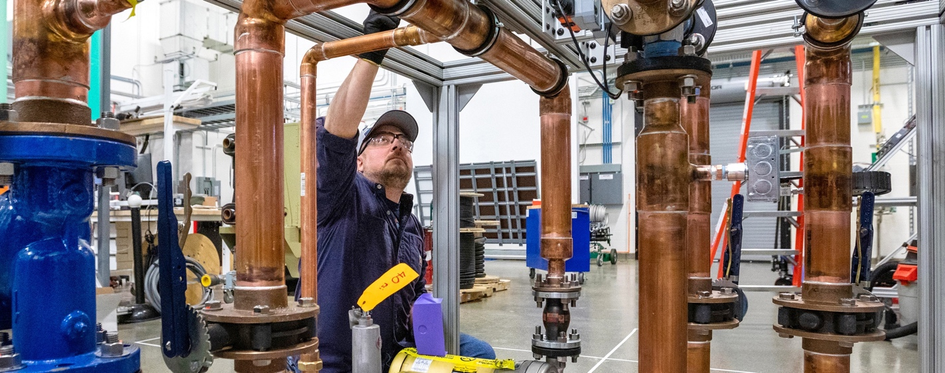
Utility-Scale Battery Storage Power Capacity
U.S. Utility-Scale Battery Storage Power Capacity (March 2019)
Megawatts (MW)
3,000
2,500
Annual Capacity Additions
2,000
Operating utility-scale battery storage power capacity has more than quadrupled from the end of 2014 (214 MW) through March 2019 (899 MW).
1,500
Operating Capacity
1,000
500
0
2003
2005
2007
2009
2011
2013
2015
2017
2019
2020
2023
Source: United States Energy Information Agency, Today in Energy, July 10, 2019
Notes:
Picture: 61236, 1/9/2020, ESIF Behind the Meter, (Photo by Werner Slocum / NREL)
Utility-scale battery storage units (units of one megawatt (MW) or greater power capacity) are a newer electric power resource, and the use of these technologies has been growing in recent years.
Operating utility-scale battery storage power capacity has more than quadrupled from the end of 2014 (214 MW) through March 2019 (899 MW).
Assuming currently planned additions are completed, and no current operating capacity is retired, utility-scale battery storage power capacity could exceed 2,500 MW by 2023.
Pairing utility-scale battery storage with intermittent renewable resources, such as wind and solar, has become increasingly competitive compared with traditional generation options.

Slide 16
Energy Storage in the United States
< 5 MW
Currently 12,678 MW of energy storage projects have been commissioned.
5-55 MW
> 55 MW
No Storage
Source: BloombergNEF, 2020 Sustainable Energy in America Fact Book
Note: Includes projects that are larger than 500kW/500kWh, have announced a specific location, and have been confirmed by the relevant company through public data. Indiana NIPSCO capacity not included in state capacity because individual project capacity is not yet disclosed.
Notes:
This map shows U. S. announced and commissioned energy storage projects.
The two largest operating utility-scale battery storage sites in the United States as of March 2019 provide 40 MW of power capacity each: the Golden Valley Electric Association’s battery energy storage system in Alaska and the Vista Energy storage system in California.
In the United States, 16 operating battery storage sites have an installed power capacity of 20 MW or greater. Of the 899 MW of installed operating battery storage reported by states as of March 2019, California, Illinois, and Texas account for a little less than half of that storage capacity.

Slide 17
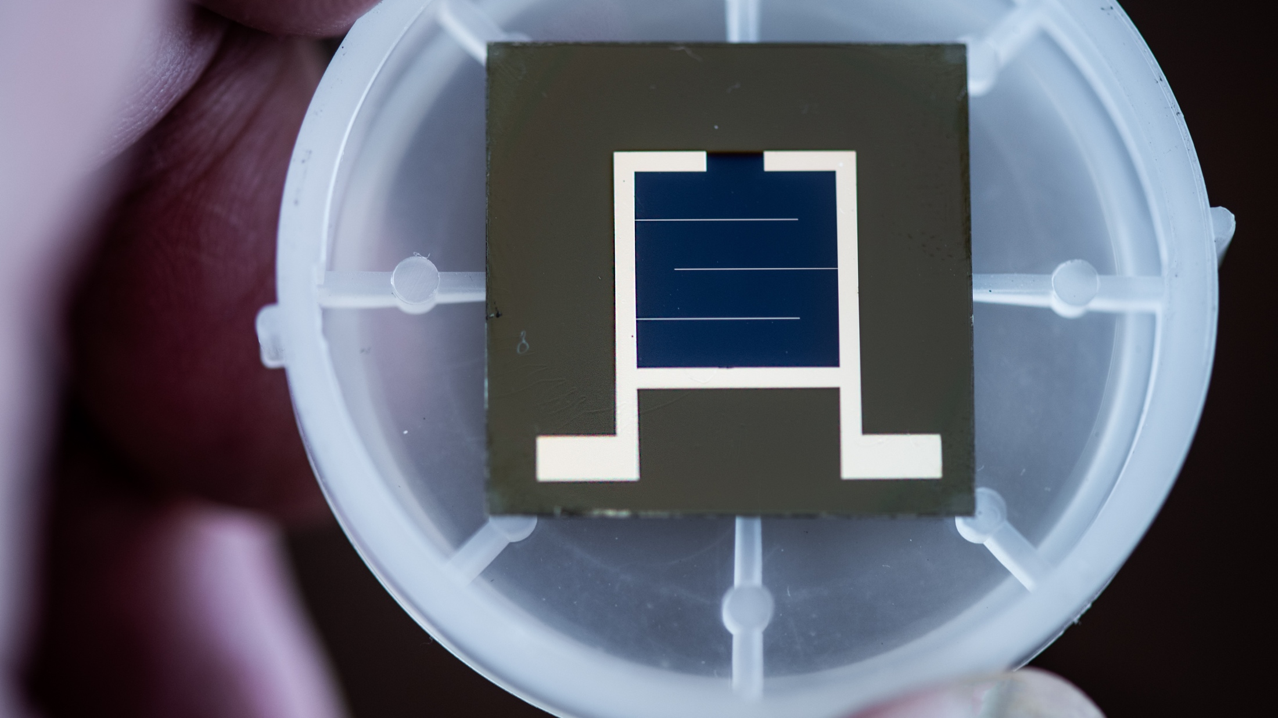
NREL’s Energy
Research is Making an Impact
Notes:
Picture: 61445, 3/2/2020, Perovskite/silicon tandem solar cells, (Photo by Dennis Schroeder / NREL)

Slide 18
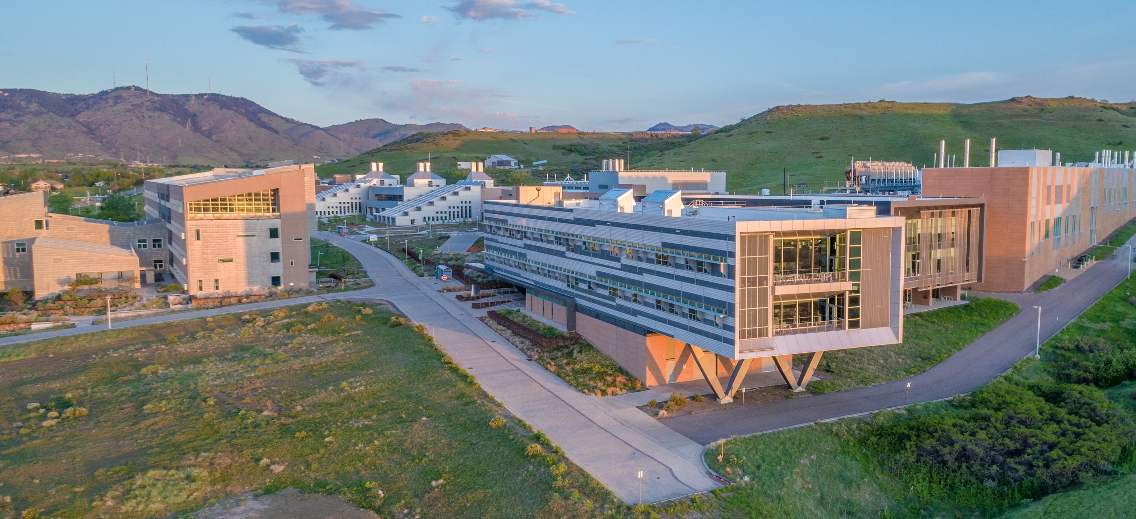


NREL at-a-Glance
2,926
More than
900
Workforce, including
219 postdoctoral researchers
60 graduate students
81 undergraduate students
World-class
facilities, renowned technology experts
Partnerships
with industry, academia, and government
Campus
operates as a living laboratory
Notes:
Picture: 61720. jpg, 6/1/2019, South Table Mountain Campus, (Photo by Joshua Bauer / NREL)
The laboratory’s research and development focuses on secure domestic energy with economic viability.
Today, NREL’s groundbreaking advanced energy research and development spans from foundational science, to research and development, to discovery and invention of methods, to components and energy delivery systems. NREL’s energy analysis informs R&D.

Slide 19
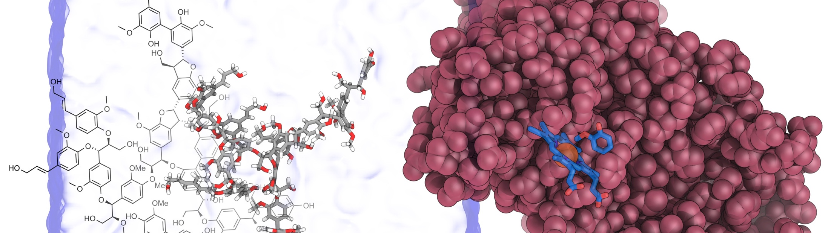

NREL Science Drives Innovation
\
\
\
\
Renewable Power
Solar
Wind
Water
Geothermal
Sustainable Transportation
Bioenergy
Vehicle Technologies
Hydrogen
Energy Efficiency
Buildings
Advanced Manufacturing
Government Energy Management
Energy Systems Integration
Grid Integration
Hybrid Systems
Security and Resilience
Notes:
59664.jpg 10/2/2019 Picture: Enabling microbial syringol conversion through structure-guided protein engineeringByline: Josh Vermass / Brandon Knott, Illustration for Joule publication, "Enabling microbial syringol conversion through structure-guided protein engineering,"
NREL science drives innovation.
Our research in these four main energy sectors boosts economic growth and helps drive the bigger engine of U. S. innovation:
Renewable Power includes solar, wind, water, and geothermal energy technologies.
Sustainable Transportation includes bioenergy, vehicle, and hydrogen technologies.
Energy Efficiency includes building technologies, advanced manufacturing research, and energy management programs.
Energy Systems Integration applies hardware-in-the-loop simulation and emulation, high-performance computing and data/visualization capabilities to assess grid modernization strategies and ways to minimize disruptions to grid services from natural disasters or human attacks.
Headline: PET eating microbe Text: Caption: April , 2019 - NREL researcher Rita Clare works with engineered enzyme Pseudomonas Putida KT2440 in her lab at the FTLB at NREL. (Photo by Dennis Schroeder / NREL)

Slide 20
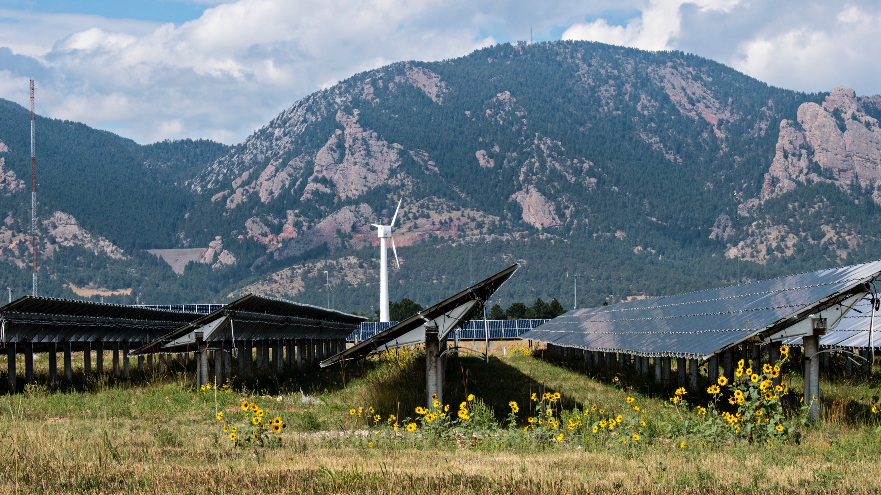
Renewable Power
Notes:
Picture: 53294, 9/6/2018, PV array NWTC, (Photo by Dennis Schroeder / NREL)
Renewable power technologies span the spectrum of clean energy – from our pioneering work in solar photovoltaics to wind, water, and geothermal energy.
Picture: 58003 June 18, 2019 - AES Lawai Solar Project- Kauai. The solar array won 2019 Best Storage Application of the Year for the world's largest battery plant paired with solar generation. The project consists of a 28 MW PV and 100MWh Battery Energy Storage System (BESS). This type of power plant produces cheap, clean energy and uses batteries to deliver power when it is most valuable, instead of just when the sun shines. Recently partnered with NREL on a distributed grid energy project, this 1.1 acre, 250kW DC pilot scale PV Array and battery storage plant will aid in meeting Hawaii's legislative mandate of 100 percent renewables by 2045, though, it requires more power delivery than just midday solar abundance. (Photo by Dennis Schroeder / NREL)

Slide 21
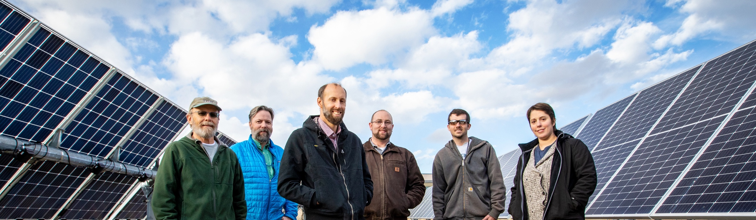
Solar Research
Areas of research include concentrating solar power, photovoltaics, grid integration, and market analysis.
Together, these areas will enable reliable, low-cost solar energy at scale—on the grid and beyond the grid.
Research Challenges
Integrate large amounts of solar energy into the power grid while maintaining security and reliability, and enhancing resilience
Improve the efficiency, lifetimes, and manufacturability of photovoltaic materials
Develop technologies for a third generation of concentrating solar power plants to further reduce costs and improve thermal storage capabilities
Capture surplus solar energy to provide heat and produce fuels and clean water
Create flexible, highly efficient solar cells that can make low-cost power available without wires anywhere the sun shines
Make solar an even better investment through work on bankability, reliability, and recyclability
Notes:
Picture: 61908.jpg,, 1/29/2020, Single Axis Tracker Team, (Photo by Werner Slocum)
Due largely to the leadership of NREL, the U. S. solar industry is growing rapidly, and solar energy is becoming more affordable and accessible than ever.
The National Center for Photovoltaics is housed at NREL, and our solar energy research includes:
Photovoltaics;
Concentrating solar power;
Solar grid and systems integration; and,
Market acceleration and soft costs.
NREL is working to enable faster, easier, and less-expensive installations by addressing “soft costs”—such as solar financing and other non-hardware costs—and market barriers through data collection, analysis, and assistance to decision-makers who affect solar markets. This crosscutting set of activities leverages NREL's unique analytical and deployment capabilities.
Picture: 59104 August 22, 2019- Robert Margolis, Mary Werner, Nancy Haegel, Wyatt Metzler, Jao VandeLagemaat, Emily Warren, Lindsay Steinman, and Teresa Barnes are co-authors of the paper, "Terawatt-Scale Photovoltaics: Transforming the Global Energy System" published in Science. (Photo by Dennis Schroeder / NREL)

Slide 22
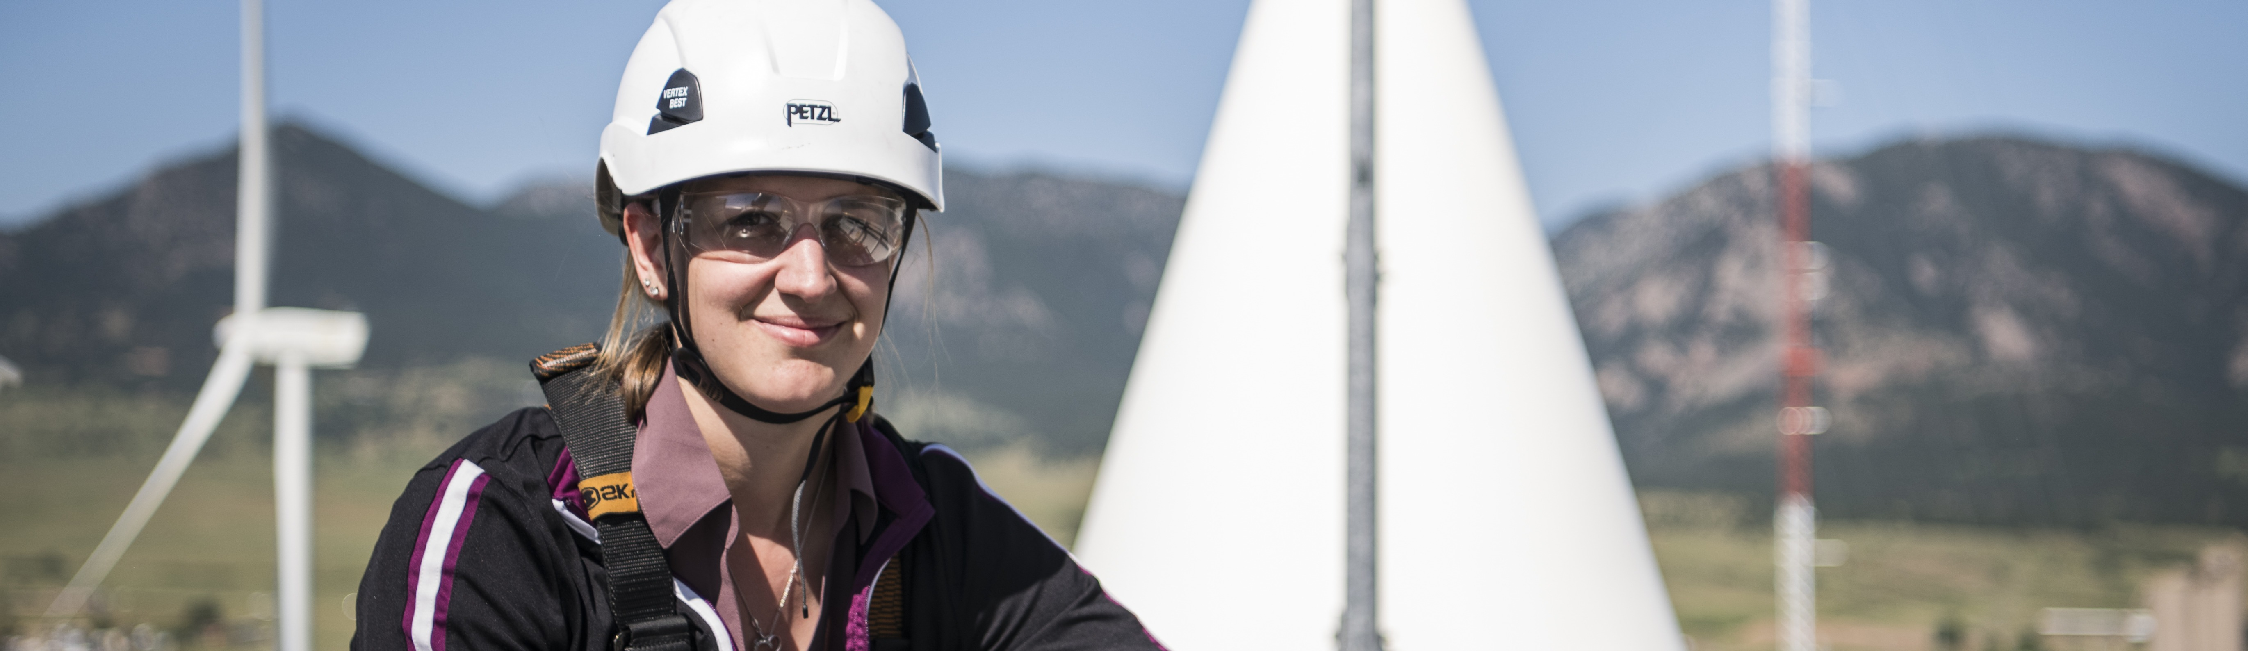
Wind Energy
Enabling low-cost and grid-supporting wind energy by joining forces with DOE, industry, and interagency and state partners to advance scientific knowledge and technological innovation.
Research Challenge
Validate multiple wind technologies at scale to achieve an integrated energy system that can meet the complex energy challenges of the future.
Develop taller wind turbines with larger rotors to capture greater wind resources at higher elevations and lower the levelized cost of wind energy.
Develop innovations for offshore wind such as floating platforms, scaling solutions for larger offshore designs, advanced turbine controls, and lightweight drivetrains.
Optimize total power output across the entirety of a wind plant instead of at the individual-turbine level.
Enable sustainable manufacturing through new materials and new manufacturing processes.
Notes:
Picture: 58259.jpg, 7/29/2019, Jennifer King, Autonomous Energy Grid, (Photo by Dennis Schroeder / NREL)
Some of the largest wind turbines in the world (3 MW) capable of powering nearly 3,000 average U.S. homes are located at NREL’s Flatirons Campus.
Utility-scale wind installations stand at more than 82 GW, enough to meet about 5.5 percent of U.S. end-use electricity demand in an average year.
Wind resources increase with altitude. The current generation of wind towers, however, will not be able to reach the height to harvest this resource.
Tall towers above 120 meters can open up to 2,000 GW of land-based wind resources in the southeastern United States. However, the key challenges are the weight of the blades and the logistics of moving large blades over roads, which is already challenging at 80 meters.
NREL’s WISDEM—a set of models for assessing overall wind plant cost of energy—is set to transform the wind industry. It is the only software that can help wind plant operators streamline operations, increase energy capture, and generate additional revenue—and it’s provided for free.
*Wind power additions continued at a robust pace in 2018, with 7,588 MW of new capacity added in the United States and $11 billion invested.
*In 2018, wind was the third largest source U.S. electric-generating capacity additions, behind solar and natural gas.
*A record level of wind power capacity entered transmission interconnection queues in 2018.
*Source 2018 Wind Technologies Market Report , U.S. Department of Energy, https://www.energy.gov/eere/wind/downloads/2018-wind-technologies-market-report
55189 Picture: February 14, 2019 - NREL researcher Julie Lundquist at the National Wind Technology Center (NWTC). (Photo by Dennis Schroeder / NREL)

Slide 23
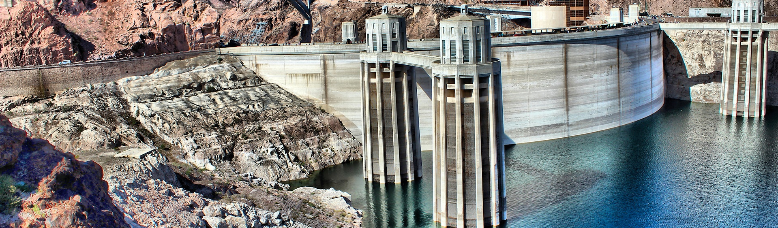
Water-Power Research
Driving innovation in the design and utilization of next generation marine energy and hydropower/pumped storage systems through foundational research, tool development, and laboratory and in-water optimization.
Research Challenges
Advancing scientific understanding to enable the full potential of hydropower/pumped storage hydropower to contribute to reliability, resilience, and renewables integration in our rapidly evolving power systems
Developing technology to enable wave, tidal, ocean, and river current energy systems to provide reliable power to utility scale and blue economy markets (e.g., ocean observing)
Transforming technology to drastically improve performance and reduce marine energy and hydropower generation costs.
Notes:
Marine and hydrokinetic energy—or ocean energy as it's sometimes called—is a burgeoning industry in the United States. NREL researchers are on the front line of design, analysis, research validation, resource, and site characterization for wave, tidal, and river and ocean current technologies.
NREL works to achieve responsible deployment of hydropower research through grid optimization, regulatory road mapping, and economic analysis. In addition, its facilities are available to support hydropower technology testing and design optimization.
Photo: Hoover Dam; Photographer: Brandi Foster
https://www.flickr.com/photos/departmentofenergy/32822770137/in/album-72157706901293751/

Slide 24
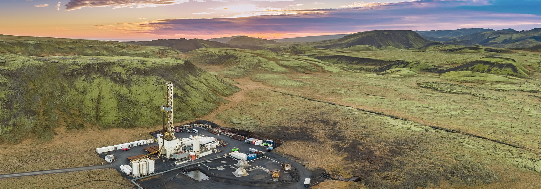
Geothermal
Geothermal provides both heat and power—24 hours a day, 7-days a week—increasing grid reliability and security, with the smallest footprint of any renewable. Reducing costs and enabling geothermal anywhere can increase deployment nearly 26-fold by 2050.
Research Challenge
Reduce well field development costs through increased drilling efficiency and drilling rates and reduced material construction costs.
Enable development of geothermal anywhere through new technologies such as Enhanced Geothermal Systems (EGS) or Advanced Geothermal Systems (AGS).
Economically recover lithium and other critical minerals from geothermal brines to meet U.S. and global demands.
Identify the feasibility of hybrid geothermal-solar systems and subsurface thermal energy storage.
Notes:
Picture: Geothermal Drilling at the Hverahlid well pad in Hverahlid, Iceland.
Photo by Ragnar Th. Sigurdsson, Iceland Drilling Company, Reykjavik, Iceland
Our geothermal research uses the heat that lies beneath the earth's surface to generate electricity and deliver direct heat for building and industrial uses, and heats and cools buildings with ground-source heat pumps.
The U.S. geothermal industry has 3 GW of installed nameplate capacity—and is developing another 1 GW of geothermal power.
NREL was the Department of Energy’s lead laboratory in the Geothermal Vision Study (GeoVision), which shows credible analysis of potential geothermal growth scenarios across multiple market sectors.
GeoVision showed that improvement in three target areas could significantly increase deployment:
Reducing regulatory timelines
Reducing well field costs
Enabling geothermal anywhere
ADVANCED WELLS
Well field construction makes up about 50% of the cost of a geothermal project. Therefore, reducing the cost of the wells is key to reducing the LCOE of geothermal. It may be possible to reduce costs by as much as 75%.
Geothermal wells are an order of magnitude more expensive than oil and gas wells. Major factors for this cost difference include:
PROBLEM: Drilling in harder rocks is slower. Oil and Gas often drills mile-a-day (“MAD”) wells. Geothermal drilling averages 175 feet per day.
SOLUTION: New drill bit technologies like Percussion Drilling, Projectile Drilling and Electronic Pulse Boring focus on drilling faster through harder rocks.
PROBLEM: Geothermal rocks are hotter. This means equipment (drill bits, downhole sensors) don’t work as well – or at all - in geothermal wells. Consequently, the equipment used in geothermal is often more rudimentary. Oil and Gas industry has suggested the geothermal industry is about 30 years behind the technology advances of the oil and gas industry.
SOLUTION: Adapt oil and gas tools, sensors, and equipment for use in high-temperature downhole geothermal environments. AND do so without raising the cost of the equipment.
PROBLEM: Poor use of data and analytics. There has been a revolution in the drilling industry in the last 10-20 years to focus on improving drilling efficiency. They industry has begun to look at drilling as manufacturing and has adopted lean manufacturing principles. This has been able to reduce drilling times by over 50%. This practice has not yet been adopted by the geothermal industry.
SOLUTION: Focus on training and deployment of these lean drilling concepts to geothermal drilling projects, stressing the importance of data collection, use and pre planning. The high-temperature sensors presented in the previous “problem/solution” will help increase the success of drilling efficiency for the geothermal industry.
PROBLEM: Geothermal wells are wider in diameter (8.25” at the bottom rather than 4”) meaning more material. They are also harsher environments (hotter), so the materials are more expensive (e.g., titanium casing)
SOLUTION: Develop advanced materials and manufacturing practices to deploy lower cost, higher resiliency well construction.
NREL is working on:
Drilling efficiency analytics
High-temperature downhole electronics
Advanced drilling technologies
GEOTHERMAL ANYWHERE
Geothermal heat is everywhere beneath the earth’s surface. At just 6,000km below ground it is as hot as the surface of the sun!
To use geothermal the geothermal heat, we need a way to get it to the surface.
Traditional geothermal sites have a fracture network and fluid present. All that’s required is for us to drill a well and pump the hot water to the surface.
But the locations where we have fractures AND fluid are limited – mostly to the western U.S. (and other areas around the world)
The next major advance would be to be able to harness the heat anywhere – from Wisconsin to Texas; California to New York.
Two example technologies:
Enhanced Geothermal Systems (EGS)
Use stimulation technology from oil and gas – needs to be adapted for geothermal
Drill three wells – one injection well (on the right) where cold water is injected; two production wells (on the left) where the heated water is pumped out for use.
A fracture network is created between the wells using stimulation technology.
DOE Geothermal Technologies Office just selected an EGS test site in Milford, Utah (called ”FORGE” – Frontier Observatory for Research in Geothermal Energy”)
They will be using this site to test emerging EGS technologies and demonstrate its feasibility.
$150M investment: $30M/year s for 5 years of research at $30M per year = total of $150M
Advanced Geothermal Systems (AGS)
Use horizontal drilling technologies from oil and gas
Examples include: Eavor Technologies (multi-lateral loop) and Greenfire Energy (single loop)
Idea is to drill the small pathways needed to conduct fluid through the hot rocks.
Greenfire Energy: Just conducted a successful demonstration project at the Coso Geothermal Plant in SE California in a single borehole that was very hot but couldn’t produce fluid. Was able to produce 1 MW of power!
Eavor Technologies: Successful demonstration projects in the Canada – additional projects planned in the Netherlands and the U.S.
NREL is working on:
Reservoir modeling, data and analytics, techno-economic modeling for both EGS and AGS.
LITHIUM RECOVERY
Lithium extraction from geothermal brines offers the potential to provide the U.S. with a secure, strategic, domestic supply of lithium to meet increasing electric vehicles demands (EVs) and for other end-use applications.
Today, lithium extraction and processing from evaporation ponds and hard-rock leaching make up approximately 60% and 40%, respectively, of the current economically profitable lithium production methods.
Lithium extraction from U.S. geothermal brine could change this significantly due to the high lithium concentrations.
NREL is working on:
techno-economics analyses of various technologies,
developing technology validation standards, and
developing new mineral separation technologies (Eric Karp – Chromatography LDRD)

Slide 25
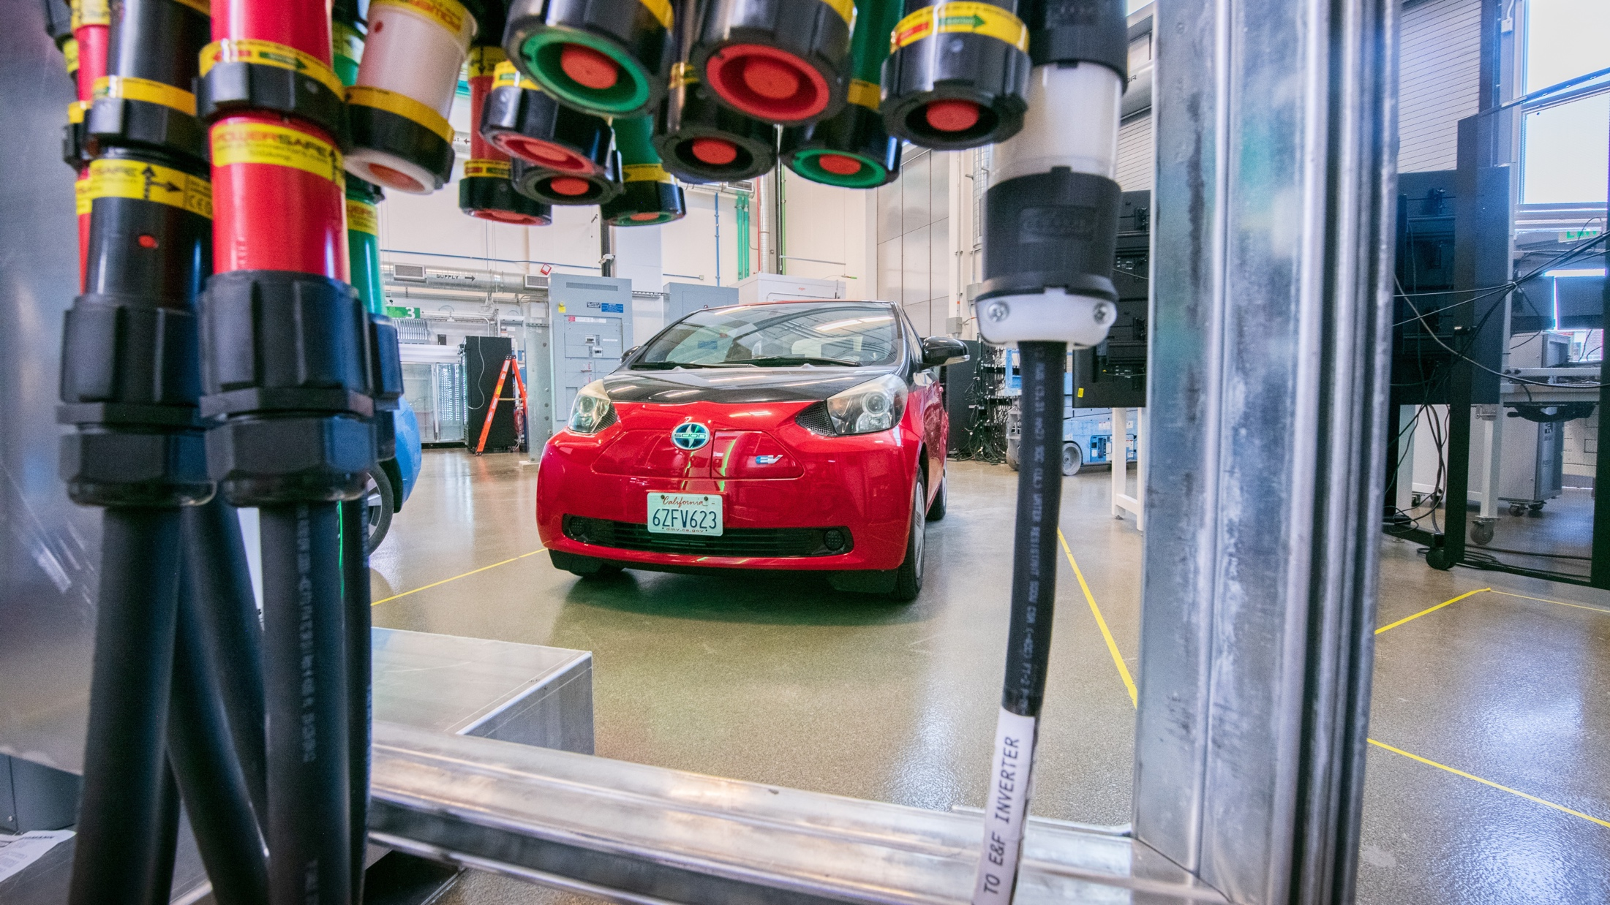
Sustainable Transportation
Notes:
Picture: 62127, 7/1/2020, Commercial Buildings Research Infrastructure (CBRI), (Photo by Dennis Schroeder / NREL)
Sustainable Transportation includes bioenergy, hydrogen, and vehicle technologies.
NREL research focuses on advanced vehicle and renewable fuels research, development, and deployment (RD&D) activities designed to lower vehicle energy consumption and emissions, while improving performance.
The laboratory draws on a broad set of capabilities to advance a range of efficient and renewable transportation technologies including electric-drive vehicle technology, hydrogen fuel cell manufacturing test processes, and biofuels/bioproducts.

Slide 26
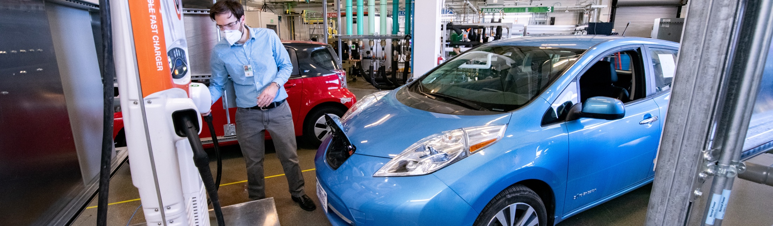
Transportation Technologies
As the nation’s premier facility for providing energy-efficient transportation R&D solutions, NREL collaborates with federal agencies, state entities, and private-sector companies to transform the movement of people and goods, while minimizing the impact to the environment.
Research Challenges
Evaluating the energy, cost, and time impacts of new mobility technologies when deployed at scale.
Identifying advanced lithium-ion battery and extreme-fast-charging technology solutions that will bring down the costs associated with electric drive transportation options.
Optimizing fuels and engines as dynamic design variables that can work together to boost efficiency and performance, while minimizing emissions.
Notes:
Picture: 62138, 7/1/2020, Commercial Buildings Research Infrastructure (CBRI), (Photo by Dennis Schroeder / NREL)
New, innovative, and integrated mobility strategies have the potential to transform the movement of people and goods, enhance national energy security, boost the domestic economy, and save individuals and businesses both time and money.
As the nation’s premier facility for providing energy-efficient transportation R&D solutions, NREL blazes new trails with novel approaches that combine vehicle, building, and infrastructure connectivity and automation to optimize mobility and increase energy efficiency. This work is done in collaboration with several federal agencies, state entities, and private-sector companies and has received several prestigious awards and patents.
Research Challenges
Energy, Cost, and Time Implications of New Mobility Technologies: In support of the SMART Mobility Consortium and the Energy Efficient Mobility Systems Program, NREL developed the Mobility Energy Productivity metric: a first-of-its-kind metric used to assess and track changes in mobility with regard to energy, time, cost, and accessibility, at a specific location; Also, looking at the impacts of multi-scale modeling with regard to Transportation Network Companies
Advanced Li-Ion Battery and Extreme Fast Charging Technology Solutions
NREL is conducting research to facilitate 10-minute charging via energy-dense electrode designs, a key enabler for NREL’s extreme fast charging (XFC) efforts.
In collaboration with NASA’s Johnson Space Center, NREL is developing a comprehensive understanding of battery failure mechanisms, risks posed during failure, and the influence of cell design on failure mechanisms.
To meet the future needs of Li-Ion batteries – in terms of safety, cost, and performance – NREL is working on developing advanced Si Anodes & low-cobalt cathodes.
NREL is administering the Lithium-ion Battery Recycling Prize for DOE to incentivize American entrepreneurs to develop processes that have the potential to profitably capture discarded or spent lithium-ion batteries for eventual recovery of key materials for re-introduction into the U.S. supply chain; and supporting the Lithium Battery R&D Recycling Center, known as ReCell, to cost-effectively reclaim and recycle critical materials from spent lithium-based batteries.
Co-Optimization of Fuels & Engines: This DOE initiative convenes experts from nine national labs and more than 20 university and industry partners to investigate fuels and engines as dynamic design variables that can work together to boost efficiency and performance, while minimizing emissions.
26

Slide 27
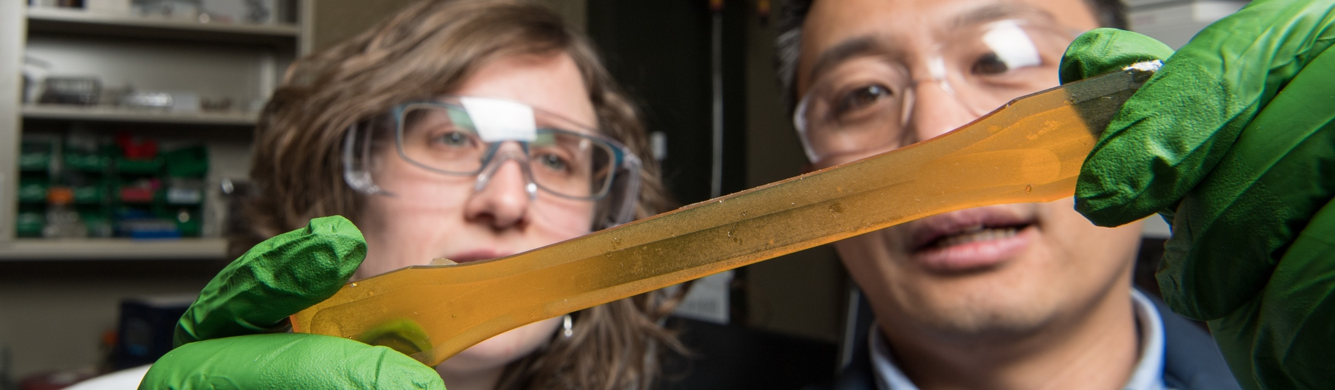
Bioenergy
Developing industrially relevant, cost-competitive, and performance-advantaged fuels, materials, and chemicals from renewable and waste carbon sources through foundational science, applied R&D, and industrial partnerships.
Research Challenges
Produce biofuel molecules that confer benefits such as higher energy content, higher octane, and lower soot formation while meeting stringent cost targets.
Develop industrially relevant bio-based materials and chemicals that provide performance advantages—such as recyclability, multifunctionality, and lower toxicity for chemicals.
Use electricity to upgrade carbon from diverse “low energy” sources such as CO₂ and other waste gases to produce high-value fuels and chemicals at acceptable cost.
Use foundational science to design, upcycle, and manufacture energy and carbon-efficient materials and processes.
Notes:
Picture: 60853, 1/09/20, Algae, (Photo by Dennis Schroeder / NREL)
The impacts of our bioenergy research and discoveries align with advanced fuels availability and adoption.
The cost of converting biomass into cellulosic ethanol has fallen by 78% due, in part, to NREL’s enzymes research and development.
NREL's biomass research and development advance the production of liquid transportation fuels from biomass. Researchers explore biomass characterization, biochemical, and thermochemical conversion processes; the chemicals and catalysts that optimize conversion; and how the steps of the process integrate with the goal to demonstrate biofuels technologies that can contribute to the production of 36 billion gallons of biofuels per year by 2022 and 60 billion gallons of biofuels per year by 2030.
NREL's Integrated Biorefinery Research Facility (IBRF) enables researchers and industry partners to develop, test, evaluate, and demonstrate processes for the production of bio-based products and fuels—all with a focus on reducing performance risk and improving the commercial viability of new processes.
NREL leads the national bioenergy initiatives through research at the National Bioenergy Center (BEC). This virtual center at NREL unifies DOE's efforts to advance technology for producing renewable transportation fuels from biomass.

Slide 28
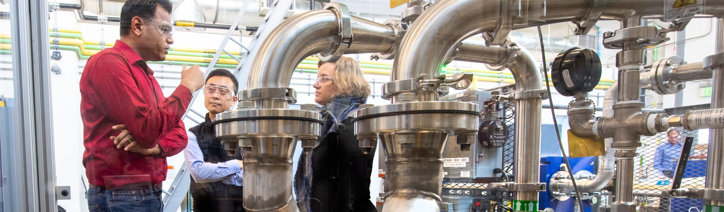
Hydrogen and Fuel Cell Research
Enabling hydrogen to be a common means of transporting, storing, and transforming energy at the scale necessary for a clean and vibrant economy.
Research Challenges
Improving the economics of hydrogen production to enable it to shift energy across time, sectors, and location—including providing electric grid support and energy storage
Developing advanced materials for polymer electrolyte fuel cells and electrolyzers, focusing on the emerging markets of intermittent H₂ production and heavy-duty transportation
Enabling safe fueling for heavy-duty hydrogen trucks, reducing the cost and improving reliability of fueling fuel cell electric vehicles
Researching hybrid bio-electrochemical processes and advanced cell concepts.
Notes:
Photo: 60027, 10/24/2019, ESIF Annual Report, (Photo by Dennis Schroeder)
Stations are dispensing hydrogen at amounts greater than we’ve ever seen in the United States.
Fuel cell vehicle sales are happening weekly.
We’ve used analysis, data validation, safety research, and hardware experiments to predict, benchmark, and innovate hydrogen infrastructure and station operation.
Sources
FCTO 2016 recap: https://www.energy.gov/eere/fuelcells/articles/fuel-cell-technologies-office-2016-recap-and-year-ahead
FCTO accomplishments: https://www.energy.gov/eere/fuelcells/fuel-cell-technologies-office-accomplishments-and-progress

Slide 29
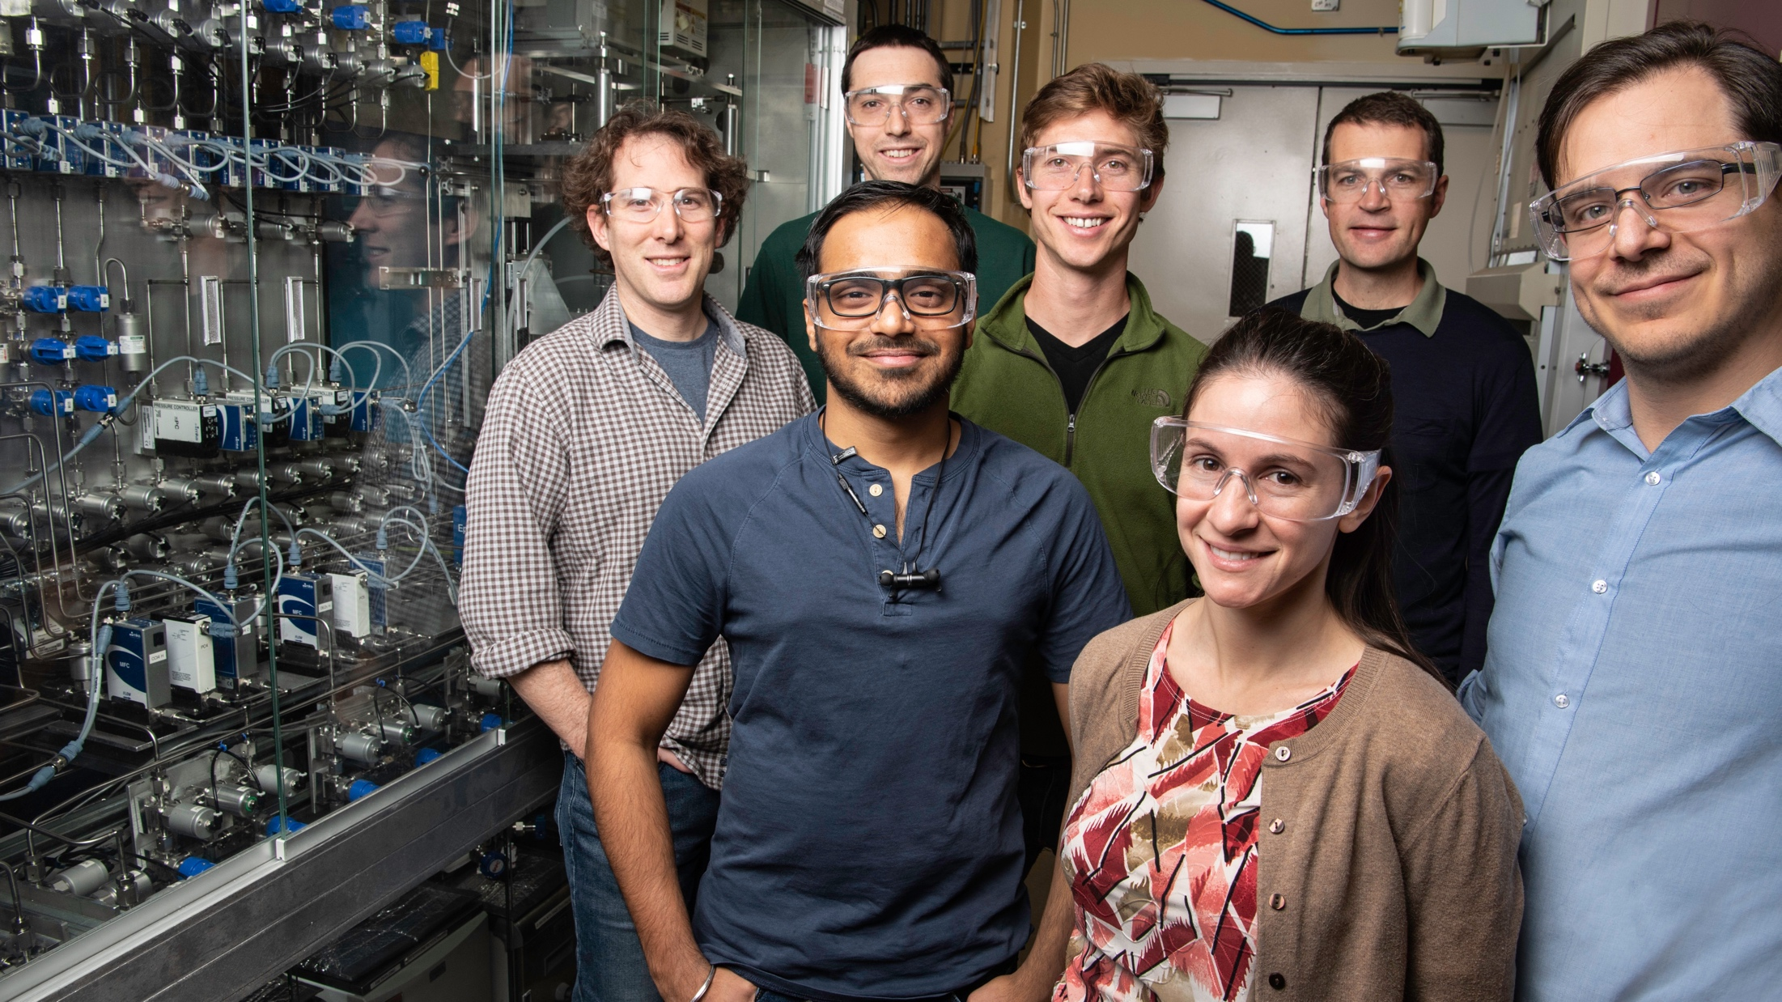
Energy Efficiency
Notes:
Picture: 60676.jpg, 12/11/2019, Antora Energy Partnership (Photo by Dennis Schroeder / NREL)

Slide 30
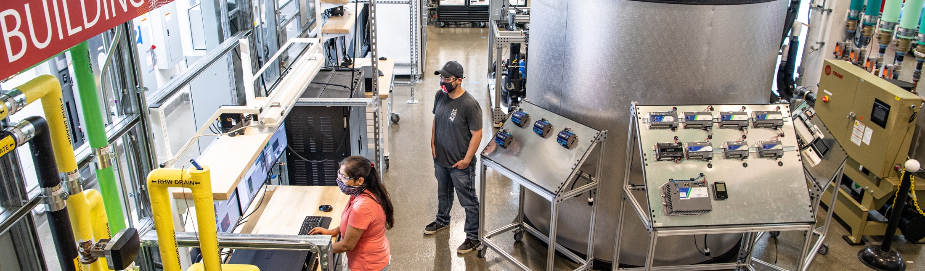
Energy Efficient Buildings
NREL’s core R&D strengths are transforming energy by developing grid-interactive buildings that strengthen the resiliency, efficiency, and affordability of energy systems globally.
Research Challenges
Developing integrated systems that include optimal design and operation.
Making smart buildings the hub for electric vehicles, solar energy, battery storage, thermal storage, and intelligent building systems that address current industry needs.
New materials and controls that enable future integration are needed.
Notes:
Picture: 62090, 7/1/2020, Commercial Buildings Research Infrastructure.(Photo by Dennis Schroeder / NREL)
Whether it's understanding emerging trends or trouble-shooting existing technical barriers, NREL has the expertise to support the building industry as it continues to evolve to address challenges. Capabilities include:
Data-driven, multi-scale building energy modeling tools;
Performance mapping and technology evaluation; and
Renewable energy integration.
Smart, efficient buildings boost U.S. economic competitiveness and help developing cities.
NREL's buildings research teams lead efforts in developing cutting-edge technical solutions to improve the energy efficiency of both residential and commercial buildings, and to accelerate the integration of renewable energy technologies with buildings.

Slide 31

Advanced Manufacturing Research
NREL’s research is focused on the identification and application of energy-efficient manufacturing solutions through the exploration of unique materials and innovative processes that enable clean energy technologies.
Research Challenges
Enabling the circular economy in wind energy by researching novel recyclable and self-healing composite resins
Understanding the intricacies of supply chain resilience through high-performance modeling and analysis
Driving the manufacturing of robust multilayer, clean-energy technologies that improve energy efficiency and reduce costs
Improving power electronic devices and reliability for stable grid connection of variable loads
Investigating the science of desalination and other clean water technologies to open untapped water resources for broad use.

Slide 32
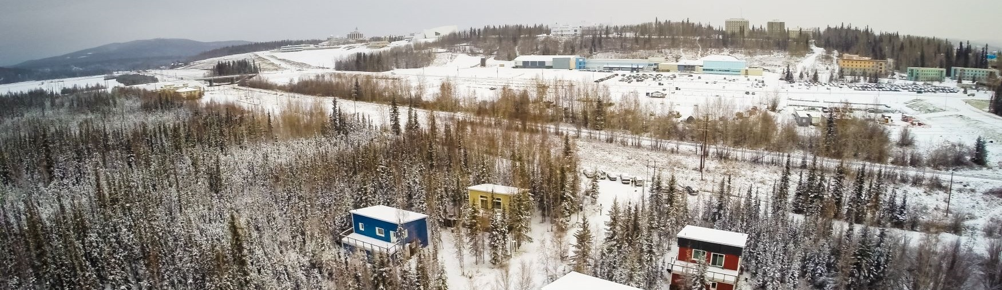
Cold-Climate Research
Alaska’s Cold Climate Housing Research Center (CCHRC) joined NREL in 2020 through an expanded partnership focused on growing DOE’s research capabilities in the Arctic.
Research Challenges
Advancing resilient, reliable, and affordable energy solutions for people living in circumpolar regions and beyond.
Validating a wide range of technologies in extreme climate conditions.
Improving the accessibility, reliability, and resiliency of cold climate technologies for Alaskan communities.
Notes:
CCHRC is visible in the upper left corner.
32

Slide 33
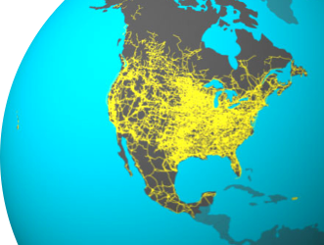
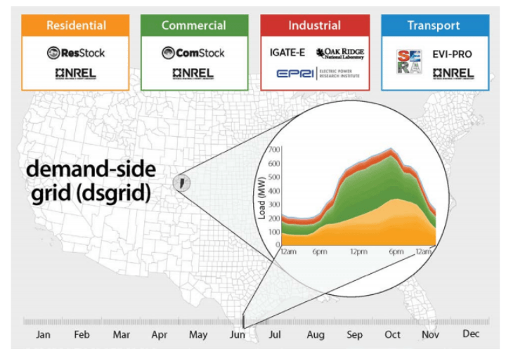
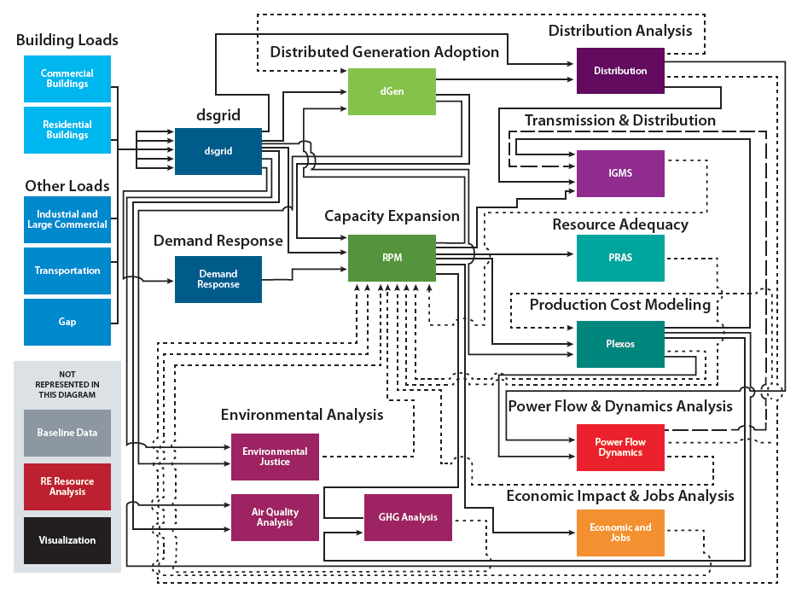
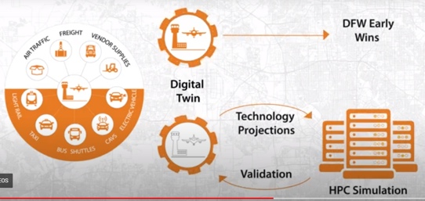
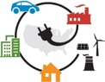

Analysis and Computing
North American Renewable Integration Study (NARIS)
Electrification Futures Study
Comprehensive, rigorous, and scalable computing and analysis.
Research Challenges
Renewable Power-Enabled Integrated Energy Pathways
Quantify potential impacts of widespread renewable-energy-based electrification of the U.S. energy economy, including power system, grid interactive buildings, electric mobility, and electrons to molecules pathways.
Equip decisionmakers to understand pathways, costs, environmental impacts, and how the economy might evolve with increased renewable electricity supply.
Use artificial intelligence to simulate impacts of future infrastructure expansion activities and improve efficiency of passenger and freight mobility in major U.S. airports
Analyzing pathways to modernize the North American power system through the efficient planning of transmission, generation, and demand.

Slide 34
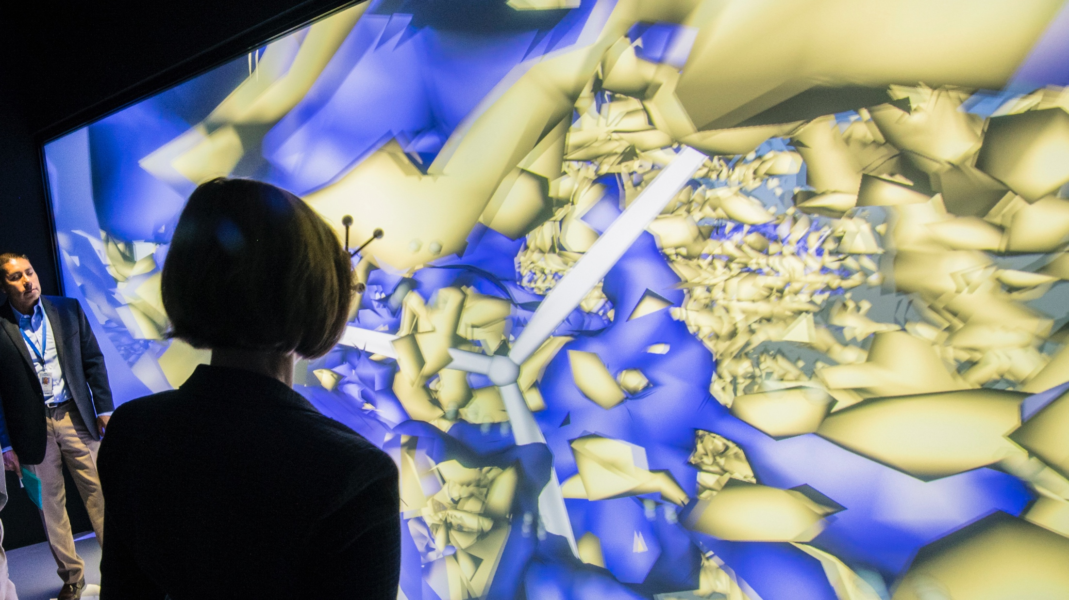
Energy Systems Integration
Notes:
Picture: 58301, 8/1/2019, U.S. House of Representatives Select Committee on the Climate Crisis (Photo by Dennis Schroeder)

Slide 35
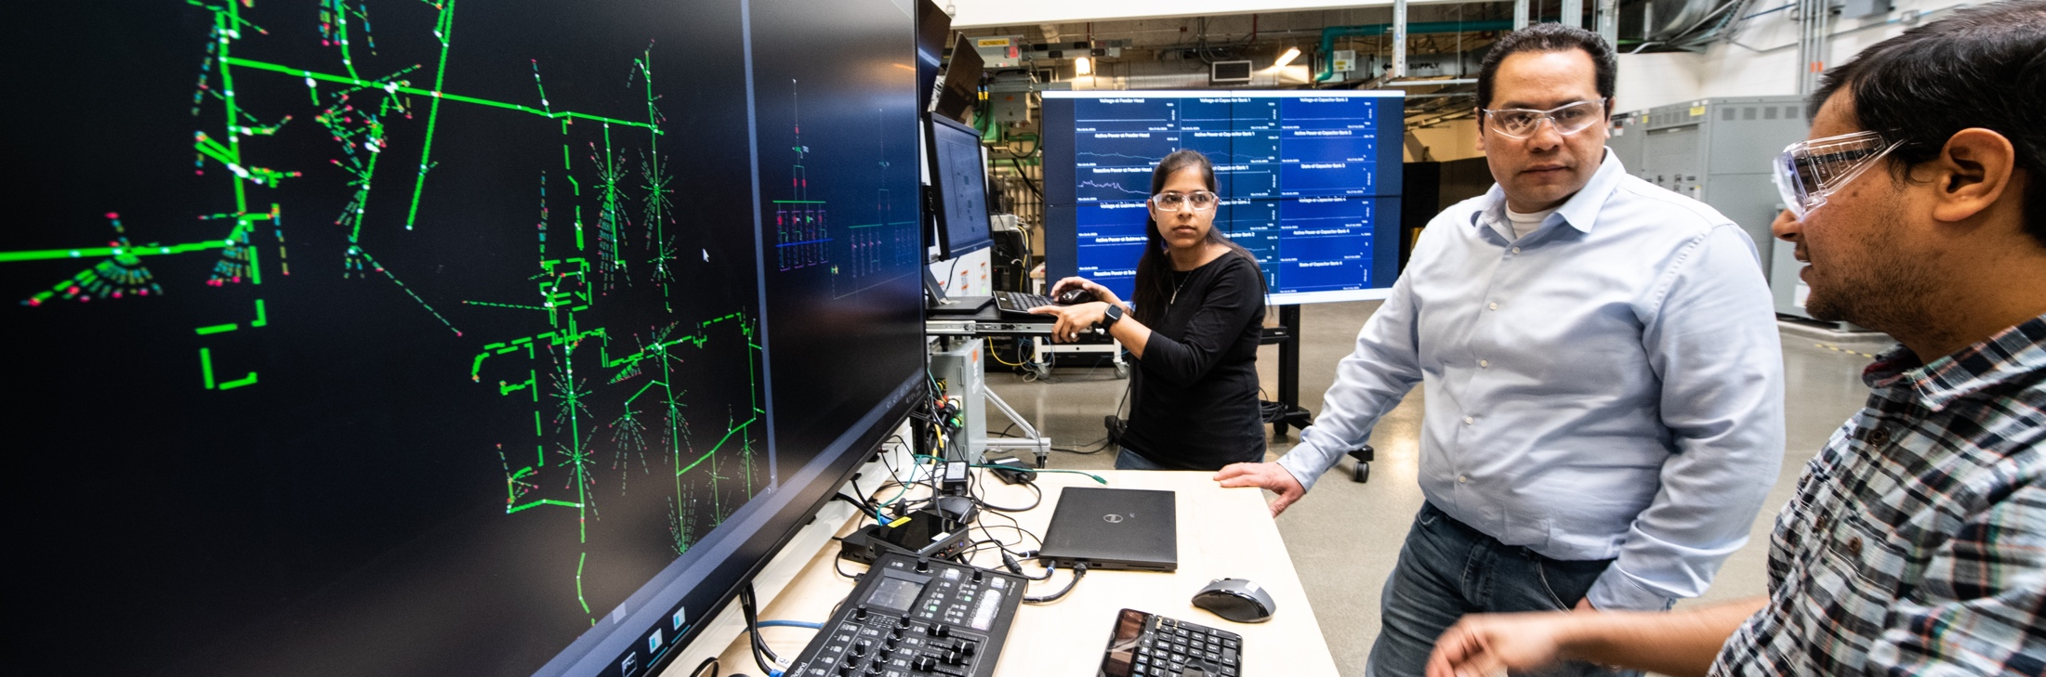
Energy Systems Integration Facility
Research Focus Areas
Renewable electricity to grid integration
Vehicle-to-grid integration
Renewable fuels-to-grid integration
Energy-water nexus
High-performance computing, analytics, and visualization
Large-scale numerical simulation
Cybersecurity and resilience
Smart home and building systems
Microgrids
Battery and thermal energy storage
Notes:
Picture: 61497.jpg, 3/5/2020, ADMS Testbed, (Photo by Dennis Schroeder / NREL)
With state-of-the-art computational modeling and predictive simulation capabilities, high-performance computing at the Energy Systems Integration Facility (ESIF) reduces the risks and uncertainty that are often barriers to industry adopting new and innovative technologies, which accelerates the transformation or our nation's energy system.
Grid modernization research is also underway at the ESIF. Scientists and engineers work with industry, government, and academia to solve the challenges of integrating renewable power sources and emerging technologies with the electric grid at all scales—while ensuring that the grid is resilient and secure in the face of growing cybersecurity and weather concerns.
=

Slide 36
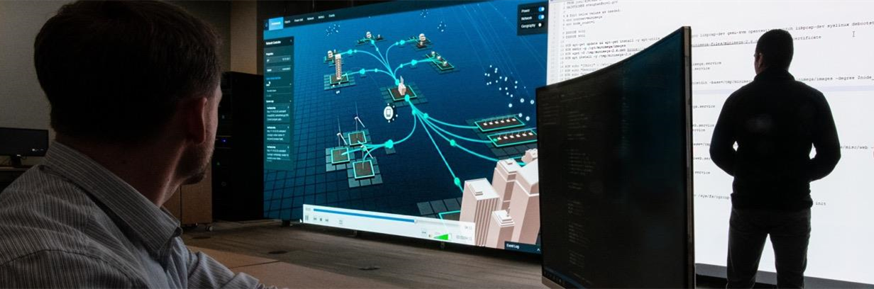
Energy Security and Resilience
Now in its second year, NREL’s Energy Security and Resilience (ESR) Center is implementing the strategic vision for a major lab-wide program that contributes to energy security and, more broadly, national security.
Establishing NREL’s role and presence through unique capability developments and publications
Catalyzing energy security and resilience work in every NREL Center
Identifying and attracting funding from new sponsors
Engaging external advisors
Notes:
Picture: 61071, 1/29/2020, Cyber Energy Emulation Platform (CEEP) (Photo by Dennis Schroeder)
Advancements in Systems Security & Resilience Tools: Examples
The Cyber-Energy Emulation (CEE) Platform uniquely generates emulated, multilayer grid environments that allow researchers to visualize and evaluate interdependencies of power systems and network communication flows—and safely explore vulnerabilities and mitigation effectiveness.
NREL’s Resilience Assessments and Tools employ diverse qualitative and quantitative approaches to inform resilience planning and valuation for partners ranging from local communities to federal agencies. The assessments and tools determine baseline conditions of a subject area; characterize hazards and threats; identify vulnerabilities; score impacts; analyze risks; and prioritize mitigation strategies.

Slide 37
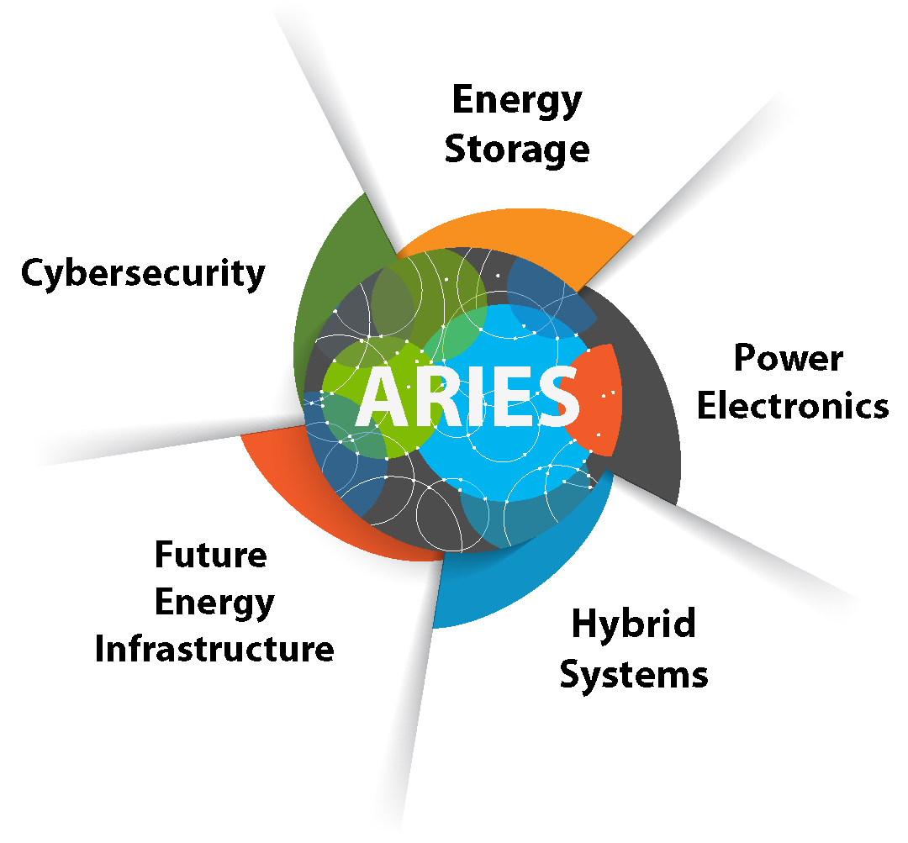
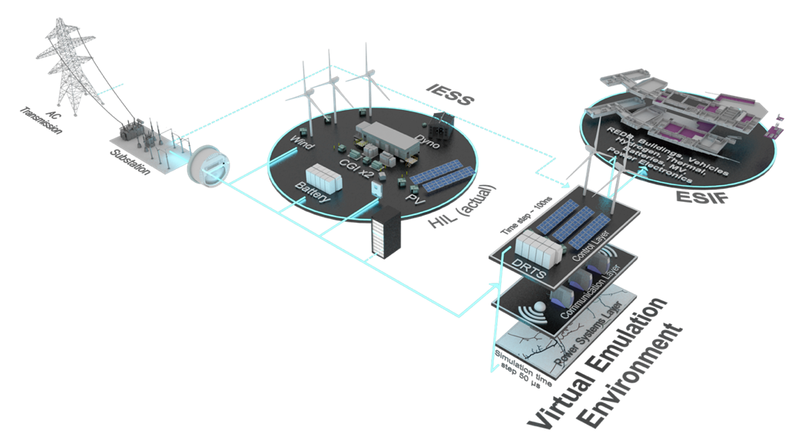
Advanced Research on Integrated Energy Systems
A unique research platform designed to de-risk, optimize, and secure current energy systems and to provide insight into the design and operation of future energy systems. Utilizing NREL’s ESIF, IESS and Virtual Emulation Environment assets.
Research Challenges
Variability in the physical size of new energy technologies being added to energy systems
Controlling large numbers (millions to tens of millions) of interconnected devices
Integrating multiple diverse technologies that have not previously worked together.
Notes:
37

Slide 38
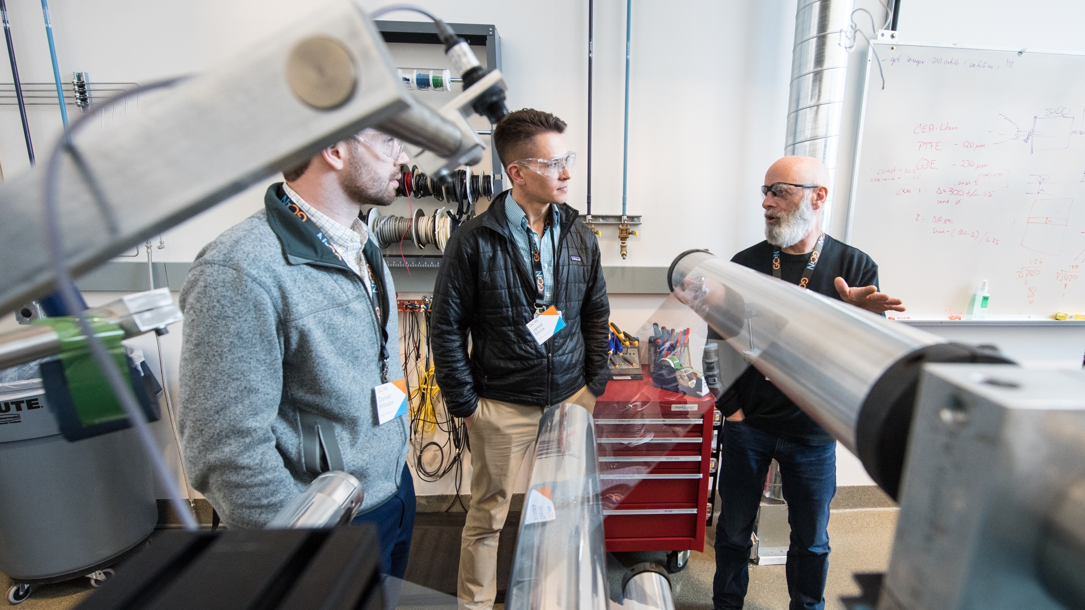
Partnering for Impact
Notes:
Picture: 61559, 2/11/20 GameChanger Cohort 3, (Photo by Dennis Schroeder / NREL)
When we partner, we accelerate the transfer of technologies to the marketplace.

Slide 39
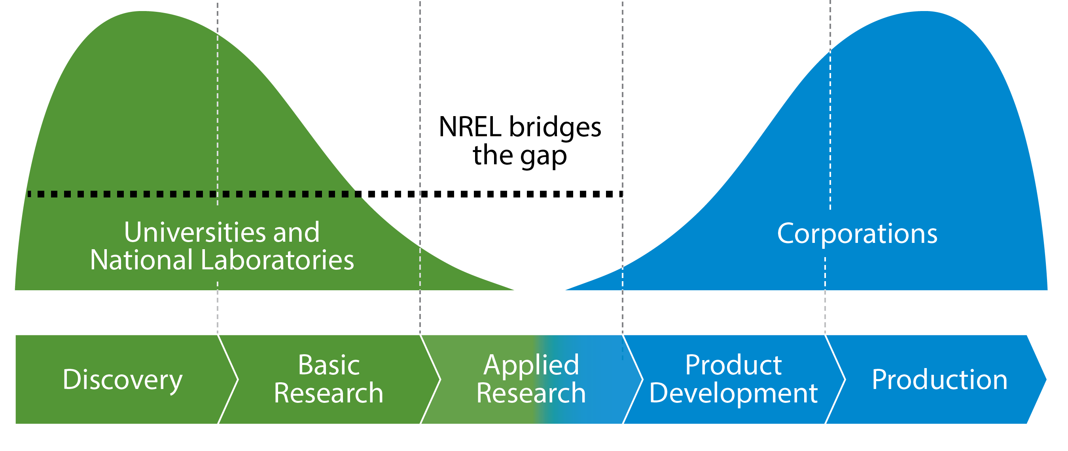
We Reduce Risk in Bringing Innovations to Market
NREL helps bridge the gap from basic science to commercial application
Forward-thinking innovation yields disruptive and impactful results to benefit the entire U.S. economy
Accelerated time to market delivers advantages to American businesses and consumers
Notes:
Without our expertise, things get a lot riskier for businesses, making it less likely that promising energy technologies make it across that wide gap from concept to market.
NREL is the only national laboratory to fully bridge the gap from foundational science research to examining the feasibility of market applications.
This forward-thinking innovation yields disruptive and impactful results to benefit the entire U.S. economy.
The accelerated R&D timeline made possible through upfront research at NREL delivers net positive returns—both for U.S. businesses and consumers.
For example, it often takes 8 to 10 years or more for new component technology to be fully deployed in commercial vehicles. Any research that NREL can conduct in advance of transferring that technology to industry makes it all the more likely that new, reliable, safe, and affordable transportation options will be available to American consumers sooner. (statistic from Transportation Energy Futures/Vehicle Technology Deployment Pathways: An Examination of Timing and Investment Constraint)
This approach allows industry to contribute expertise where it is most valuable:
Car companies focus on vehicle engineering, not testing the reliability of a hydrogen fueling station.
Energy companies concentrate on operational decisions, not keeping detailed data on where the sun shines.
Individual companies can be confident that on-site charging stations will be economically beneficial without needing to build a grid-scale testing facility that they only need to use a few times a year.
That’s why companies such as Exxon, Eaton, Duke Energy, GE, and many other industry partners rely on our research expertise – as well as tools, data, and expert analysis – to help steer billions of dollars in manufacturing and workforce development investments.

Slide 40
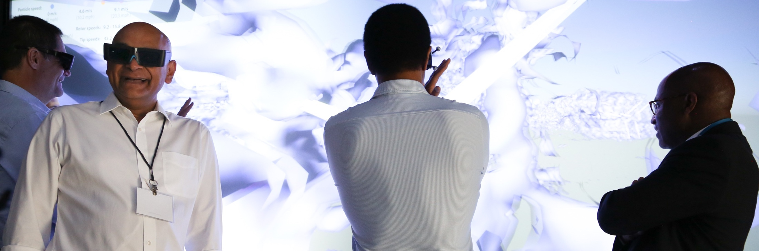
Why Can’t Industry Do What We’re Doing?
Industry invests in short-term R&D when they are confident about a return on investment. NREL:
Assumes a longer, broader view.
Takes on early-stage, high-risk R&D.
Conducts research that makes it possible for industry to bring important new solutions to the market.
“It is often too risky for the private sector to be on that bleeding edge of research where profits are years and years away.”
Venkatesh Narayanamurti, Harvard Kennedy School professor of science and technology policy, told The Washington Post
Notes:
Picture: 58976.jpg, 8/13/2019, Eaton Tour at the Energy Systems Integration Facility, (Photo by Amy Glickson)
NREL scientists and engineers are able to take a longer and broader view focused on the good of the nation as a whole, rather than returns for one individual company.
We take on early-stage, high-risk R&D that leads to dramatic innovation, then make those breakthrough discoveries available to American companies, which gives U.S. industry a leg up.
Our world-class researchers provide the scientific building blocks for new technologies and approaches, answering key questions about technological and commercial viability, making it possible for industry to bring important new solutions to market faster.

Slide 41

Partnering with Business for Competitive Advantage
More than 900 active partnerships with industry, academia, and government
In 2020 NREL had:
274
$102M value
242
563
new partnership agreements
of new partnership agreements
unique new partnerships
unique active partnerships
Notes:
Picture: 54593, 11/27/2018 Dallas Fort Worth ATHENA System, (Photo by Dennis Schroeder / NREL)
NREL can help solve energy challenges and increase the pace and scale of innovations in energy efficiency, sustainable transportation, and renewable power technologies.
NREL enables industry, government, research, and nonprofit partners to conceive innovative ideas, develop concepts into prototypes, and accelerate market-ready technologies. Together, we can address the nation's energy challenges while strengthening U.S. economic competitiveness and supporting America's homes, businesses, and infrastructure.
Since 2000, NREL has executed more than 200 royalty-bearing licenses, and we currently have more than 750 patented, patent-pending, or copyrighted technologies available for licensing.
60149 Headline: Holy Cross Energy, Home PV Caption: November 1, 2019 - A new powerfield PV array built outside of Holy Cross Energy Coop in Glenwood Springs. Holy Cross Energy, a 43,000 member Energy Coop, is pioneering a distributed grid with the help of it's members. (Photo by Dennis Schroeder / NREL)

Slide 42




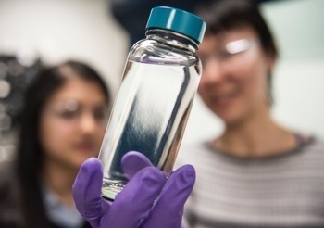
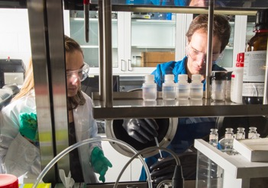
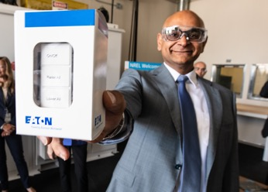
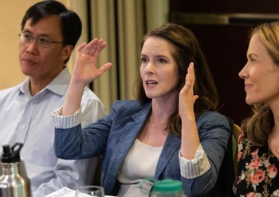
More than 900 Valuable Partnerships
This is a 10-year $100 million partnership that is intended to fill gaps in traditional energy approaches. Our scientists and engineers are collaborating to conceive and create solutions for today’s energy challenges.
Shell Gamechanger Powered by NREL is our five-year multi-million-dollar partnership program with Shell. We have branded the program GCxN, and it focuses on battery longevity and advanced smart grid controls.
NREL and Eaton are working together in the ESIF on grid intelligence, distributed energy resource management, advanced energy storage systems, virtual modeling and analysis, high-performance computing and other research.
Our Innovation Incubator (IN₂) is expanding this scalable model to other partners and technologies and growing to a multiyear, $30 million program.
Notes:
Pictures: Far left, 55268, Biomass Research; Center left, 55097, Battery Lab; Center right, 51043, Eaton (Photos by Dennis Schroeder) Picture far right: 52850, IN2 Advisory Board, (Photo by Werner Slocum / NREL)
Partnership Stats
299 New Partnership Agreements
$74M in New Partnership Agreements Value
871 Active Partnership Agreements
255 Unique New Partners
587 Unique Active Partners
Partnership Percentage Breakdown 35% large business
23% small business
18% federal government
9% educational institution
8% nonprofit organization
7% state or local government

Slide 43
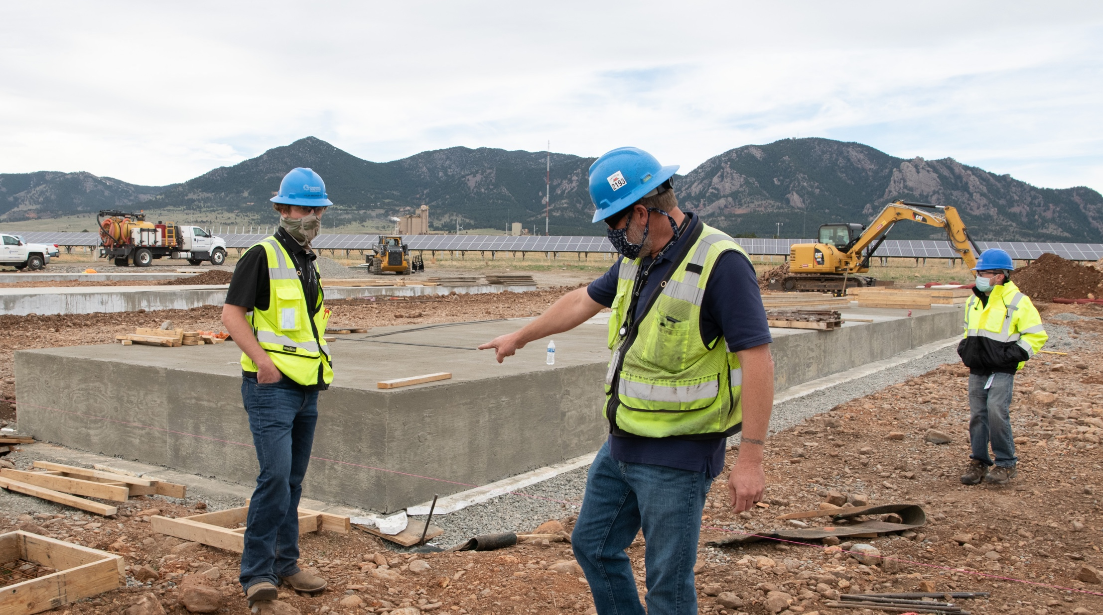



NREL Advanced Research and Innovations
Create American jobs
Boost U.S. economic growth
Strengthen our energy security
Notes:
Picture: 61854.jpg, 4/30/20, Headline: COVID-19, (Photo by Dennis Schroeder)
Because of the convergence of federal research and industry need, an energy revolution is sweeping the nation. Cutting-edge innovations are:
creating American jobs
boosting economic growth
and strengthening U.S. energy security.
Picture: 57354 May 9, 2019 - College teams from around the country take part in the 2019 Collegiate Wind Competition at the National Wind Technology Center (NWTC) near Boulder, Colorado. Twelve teams competed in the three-day event. (Photo by Werner Slocum / NREL)

Slide 44
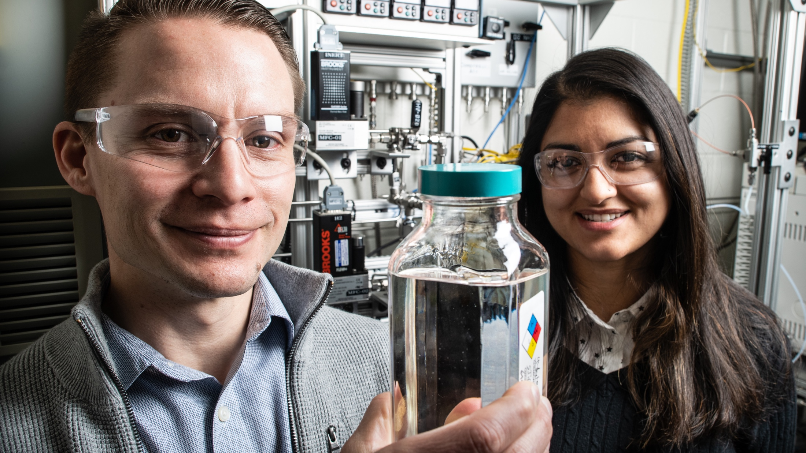
NREL Leads America’s
Energy Future
Notes:
Picture: 60442.jpg,12/5/2019, Biodiesel Bioblend, (Photo by Dennis Schroeder)
In order for America to continue to be a global energy leader and be at the forefront of the next technological revolution, it is vitally important to maintain support for federally funded R&D.
What’s next?
Our work in perovskite materials research is increasing the efficiency and stability of lower-cost solar cells.
Our scientists taking waste plastics and upcycling them into higher value products.
Our research in composite materials is leading to breakthroughs in the local manufacturing of domestic wind turbines.
We are collaborating with partners to convert electricity and small waste gasses (e.g. CO₂, H₂O, N₂) into chemical bonds for the purposes of chemical, material or fuel synthesis and/or energy storage.
We are blazing new trails with new approaches to transportation that combine vehicle, building, and infrastructure connectivity and automation to optimize mobility and reduce energy consumption.
And we are focusing our energy systems integration efforts to create components and systems for a future grid that is agile and responsive.
NREL LEADS AMERICA’S ENERGY FUTURE
Photo: August 21, 2017 - NREL staff view the solar eclipse at the OTF on the STM campus. (Photo by Dennis Schroeder / NREL 46862)

Slide 45

NREL’s 10-Year Plan:
A Vision for the Future
Notes:
Talking Points
The future will be defined not only by a need for more resilient and accessible energy, but also by greater and more varied types of demand. As our population, urbanization, and global affluence all increase, so will our demand on the world’s energy resources.
Photo: iStock-861165648

Slide 46



Integrated Energy Pathways
Electrons to Molecules
Circular Economy for Energy Materials
NREL’s Vision
Three critical research areas respond to today’s energy challenges and provide tomorrow’s solutions
Notes:
Talking Points
NREL is meeting this challenge head-on by focusing our expertise and resources on three research areas that will accelerate the transformation of traditional energy products, practices, and industries. This requires more than simply enabling low-cost renewable and low-carbon electricity generation. It also means moving toward two-way power flow and digitization (Integrated Energy Pathways); developing new, high-carbon utilization methods to capture carbon molecules from today’s fossil fuels and use them in new ways (Electrons to Molecules); and rethinking how products are designed and recycled for maximum material efficiency (Circular Economy for Energy Materials).
NREL is Transforming Energy – how we generate, consume, store, and distribute it. And we invite others to join us in that effort.

Slide 47
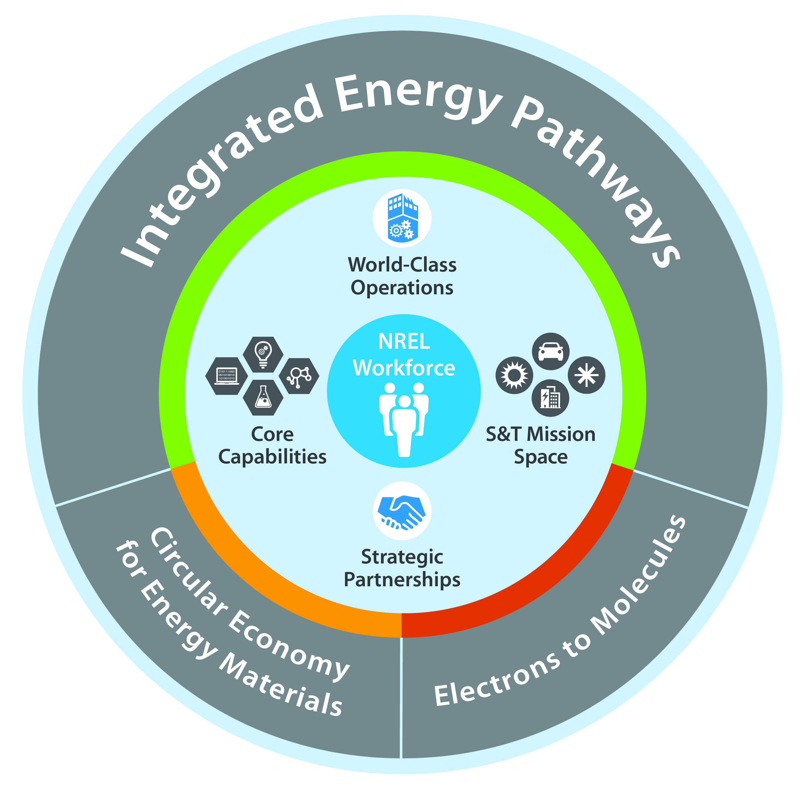
Working Toward Our Vision
Note: There are three versions of this graphic available. Please use the one that has the most appropriate level of detail for your audience – you do not need to use all three.
Notes:
Talking Points
NREL’s 10-year vision transforms today’s energy challenges into tomorrow’s solutions
The strategy is based on a three-pronged approach:
NREL’s vision lays the foundation for scientific research and technological innovation to shape a highly efficient and resilient energy future.
Key Point: NREL’s long-term vision considers major external megatrends and contemplates possible futures for the world.
Key Point: The laboratory’s vision charts a course for continued leadership in energy innovation and transforming energy systems around the world.
NREL’s long-term vision focuses on three critical research areas that respond to existing energy challenges and will increase our impact.
Key Point: Integrated Energy Pathways is our key strength as it aligns with our core research capabilities and mission; Electrons to Molecules and Circular Economy for Energy Materials are emerging opportunities expected to help address future global energy challenges.
Key Point: Our strategic vision for the next decade builds on our core capabilities and programs to enhance our impact through these three research areas.
Key Point: These three primary areas of opportunity strongly leverage our existing research and development activities but also call on us to expand on and create new capabilities.
NREL’s vision informs the laboratory’s research roadmap and also serves as a guide for others wanting to collaborate and innovate toward similar goals.
Key Point: NREL’s long-term vision is elevated by our work with partners in industry, academia, governmental institutions, and other organizations.
Key Point: The essence of this vision is to chart a course from the current state of our S&T programs and core capabilities to a future state in which we have the programmatic support, partnerships, and capabilities needed to achieve these critical objectives and truly transform global energy systems.
NREL already is making substantial investments in our S&T programs and core capabilities to support these objectives through our annual operating plans (AOPs) and targeted Laboratory Directed Research and Development (LDRD) projects. We also are actively proposing new research projects in existing programs that align with this strategy—providing this prospective thought leadership for DOE is one critical role we play as a national laboratory.
Mission Support
NREL’s mission support functions are foundational to our success in meeting these critical objectives and, more broadly, our current set of S&T priorities. These functions make it possible to:
Recruit and retain the right people with the right knowledge and expertise
Build and maintain critical facilities and systems and keep them secure
Procure and maintain our essential research and operational equipment to ensure safety
Develop an implementation plan and communications strategy to promote our progress
Manage the agreements and finances to ensure efficient business practices
Foster strategic partnerships to elevate our impact
This strategic plan will help us transform our S&T programs and core capabilities to a future state in which we have the programmatic support and capabilities needed to build a robust research portfolio enabling the three critical objectives. This effort will provide a partnership portfolio and impactful research that accelerates transformative innovations and their adoption in the market, which will help us contribute critical innovations to advance scalable solutions in the United States and across the globe. To chart this course effectively, we must acquire the facilities and equipment needed to implement them, expand the reach of our partnerships, and support our people with the work environment they need to be successful.

Slide 48
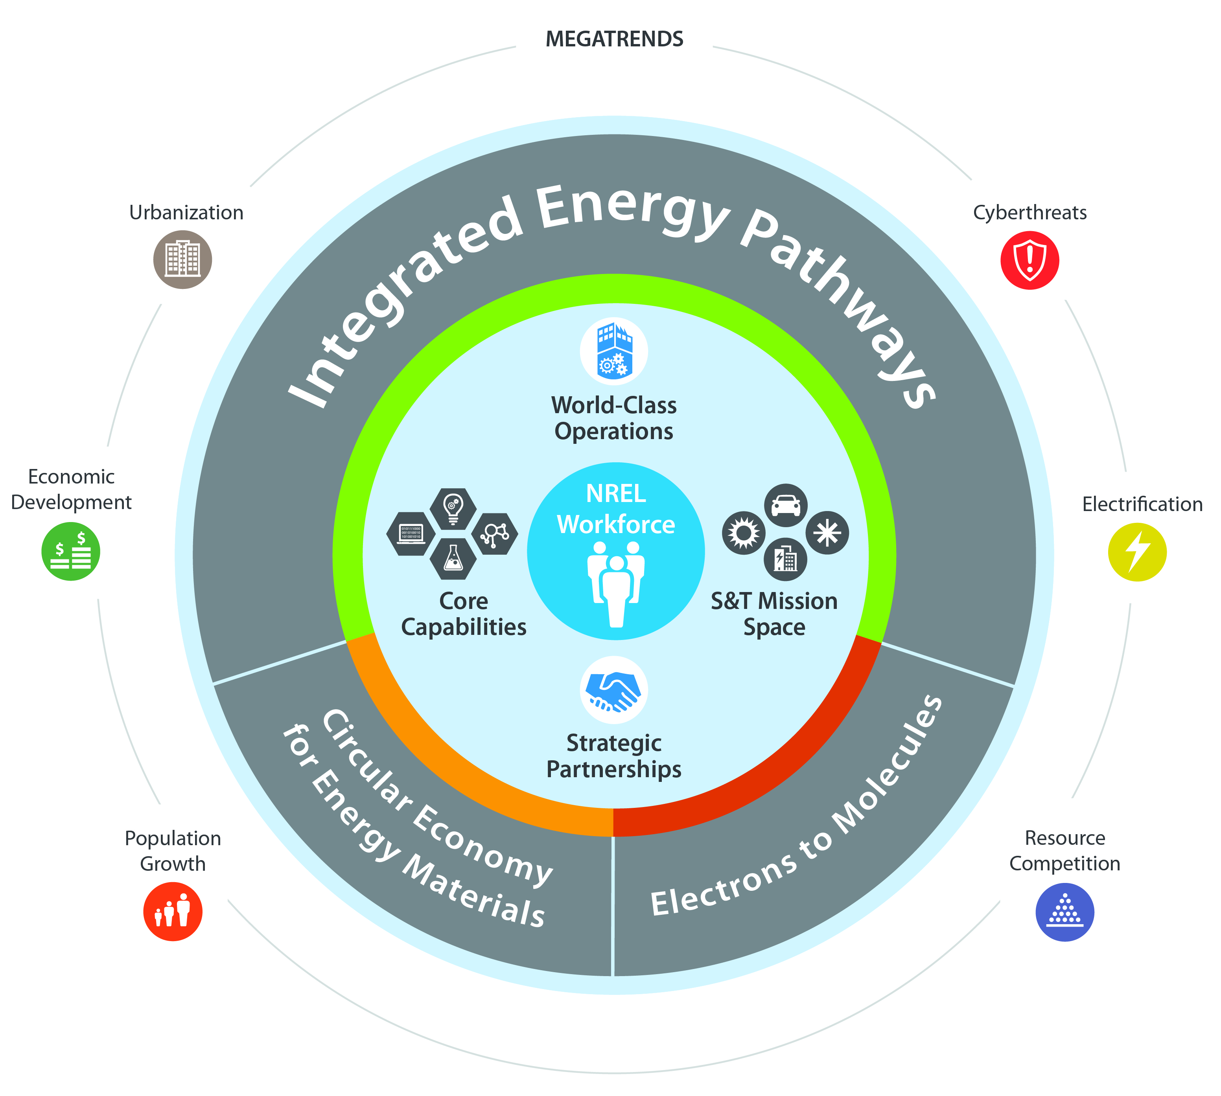
Working Toward Our Vision
Note: There are three versions of this graphic available. Please use the one that has the most appropriate level of detail for your audience – you do not need to use all three.
Notes:
Talking Points
NREL’s 10-year vision transforms today’s energy challenges into tomorrow’s solutions
The strategy is based on a three-pronged approach:
NREL’s vision lays the foundation for scientific research and technological innovation to shape a highly efficient and resilient energy future.
Key Point: NREL’s long-term vision considers major external megatrends and contemplates possible futures for the world.
Key Point: The laboratory’s vision charts a course for continued leadership in energy innovation and transforming energy systems around the world.
NREL’s long-term vision focuses on three critical research areas that respond to existing energy challenges and will increase our impact.
Key Point: Integrated Energy Pathways is our key strength as it aligns with our core research capabilities and mission; Electrons to Molecules and Circular Economy for Energy Materials are emerging opportunities expected to help address future global energy challenges.
Key Point: Our strategic vision for the next decade builds on our core capabilities and programs to enhance our impact through these three research areas.
Key Point: These three primary areas of opportunity strongly leverage our existing research and development activities but also call on us to expand on and create new capabilities.
NREL’s vision informs the laboratory’s research roadmap and also serves as a guide for others wanting to collaborate and innovate toward similar goals.
Key Point: NREL’s long-term vision is elevated by our work with partners in industry, academia, governmental institutions, and other organizations.
Key Point: The essence of this vision is to chart a course from the current state of our S&T programs and core capabilities to a future state in which we have the programmatic support, partnerships, and capabilities needed to achieve these critical objectives and truly transform global energy systems.
NREL already is making substantial investments in our S&T programs and core capabilities to support these objectives through our annual operating plans (AOPs) and targeted Laboratory Directed Research and Development (LDRD) projects. We also are actively proposing new research projects in existing programs that align with this strategy—providing this prospective thought leadership for DOE is one critical role we play as a national laboratory.
Mission Support
NREL’s mission support functions are foundational to our success in meeting these critical objectives and, more broadly, our current set of S&T priorities. These functions make it possible to:
Recruit and retain the right people with the right knowledge and expertise
Build and maintain critical facilities and systems and keep them secure
Procure and maintain our essential research and operational equipment to ensure safety
Develop an implementation plan and communications strategy to promote our progress
Manage the agreements and finances to ensure efficient business practices
Foster strategic partnerships to elevate our impact
This strategic plan will help us transform our S&T programs and core capabilities to a future state in which we have the programmatic support and capabilities needed to build a robust research portfolio enabling the three critical objectives. This effort will provide a partnership portfolio and impactful research that accelerates transformative innovations and their adoption in the market, which will help us contribute critical innovations to advance scalable solutions in the United States and across the globe. To chart this course effectively, we must acquire the facilities and equipment needed to implement them, expand the reach of our partnerships, and support our people with the work environment they need to be successful.

Slide 49
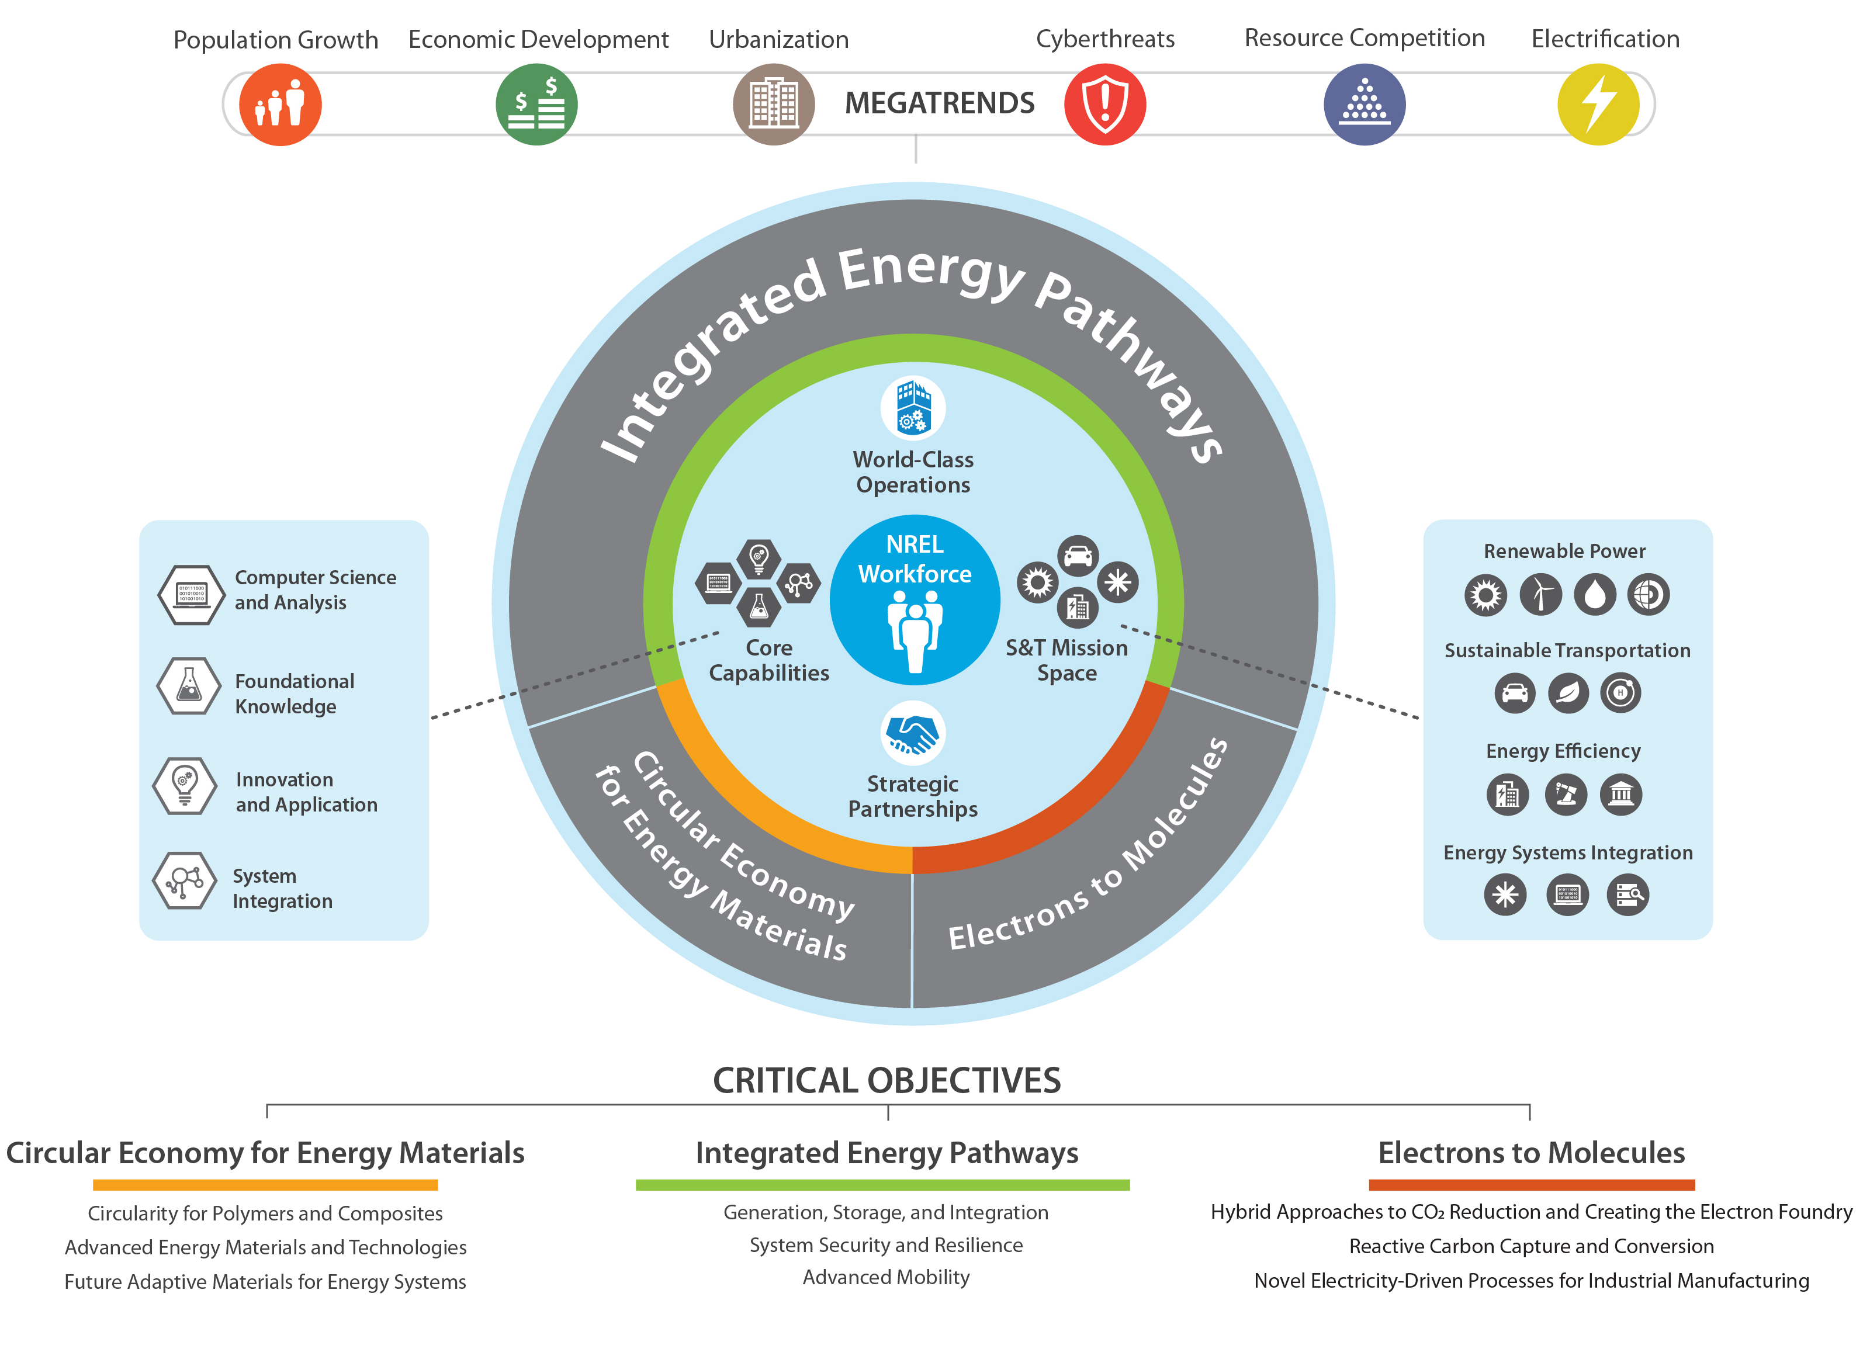
Working Toward Our Vision
Note: There are three versions of this graphic available. Please use the one that has the most appropriate level of detail for your audience – you do not need to use all three.
Notes:
Talking Points
NREL’s 10-year vision transforms today’s energy challenges into tomorrow’s solutions
The strategy is based on a three-pronged approach:
NREL’s vision lays the foundation for scientific research and technological innovation to shape a highly efficient and resilient energy future.
Key Point: NREL’s long-term vision considers major external megatrends and contemplates possible futures for the world.
Key Point: The laboratory’s vision charts a course for continued leadership in energy innovation and transforming energy systems around the world.
NREL’s long-term vision focuses on three critical research areas that respond to existing energy challenges and will increase our impact.
Key Point: Integrated Energy Pathways is our key strength as it aligns with our core research capabilities and mission; Electrons to Molecules and Circular Economy for Energy Materials are emerging opportunities expected to help address future global energy challenges.
Key Point: Our strategic vision for the next decade builds on our core capabilities and programs to enhance our impact through these three research areas.
Key Point: These three primary areas of opportunity strongly leverage our existing research and development activities but also call on us to expand on and create new capabilities.
NREL’s vision informs the laboratory’s research roadmap and also serves as a guide for others wanting to collaborate and innovate toward similar goals.
Key Point: NREL’s long-term vision is elevated by our work with partners in industry, academia, governmental institutions, and other organizations.
Key Point: The essence of this vision is to chart a course from the current state of our S&T programs and core capabilities to a future state in which we have the programmatic support, partnerships, and capabilities needed to achieve these critical objectives and truly transform global energy systems.
NREL already is making substantial investments in our S&T programs and core capabilities to support these objectives through our annual operating plans (AOPs) and targeted Laboratory Directed Research and Development (LDRD) projects. We also are actively proposing new research projects in existing programs that align with this strategy—providing this prospective thought leadership for DOE is one critical role we play as a national laboratory.
Mission Support
NREL’s mission support functions are foundational to our success in meeting these critical objectives and, more broadly, our current set of S&T priorities. These functions make it possible to:
Recruit and retain the right people with the right knowledge and expertise
Build and maintain critical facilities and systems and keep them secure
Procure and maintain our essential research and operational equipment to ensure safety
Develop an implementation plan and communications strategy to promote our progress
Manage the agreements and finances to ensure efficient business practices
Foster strategic partnerships to elevate our impact
This strategic plan will help us transform our S&T programs and core capabilities to a future state in which we have the programmatic support and capabilities needed to build a robust research portfolio enabling the three critical objectives. This effort will provide a partnership portfolio and impactful research that accelerates transformative innovations and their adoption in the market, which will help us contribute critical innovations to advance scalable solutions in the United States and across the globe. To chart this course effectively, we must acquire the facilities and equipment needed to implement them, expand the reach of our partnerships, and support our people with the work environment they need to be successful.

Slide 50

Electrification of the Economy
Integrated Energy Pathways
Concept
Create new, value-added, highly resilient integrated energy systems
Benefit
Increases reliance on domestic resources to enhance security and resiliency and enable economic growth
Challenges
Providing scalable renewable generation and storage
Developing secure, resilient, and cost-effective technologies and systems
Enabling systems integration of transportation, buildings, industry, renewables, and the grid
Notes:
Picture: iStock-846746818
Talking Points
Integrated Energy Pathways focuses on modernizing our grid to support a broad selection of generation types, encourage active participation by the consumer, and expand our options for transportation electrification.
Today’s electric grid was built around century-old concepts and technologies, not the needs and opportunities of tomorrow’s emerging system. Energy technologies have evolved in multiple sectors, leading to diversity in how and where energy is generated. This diversity has not only turned one-way power flow on its head, but it also has opened the door to unprecedented energy resilience and efficiency as well as advanced mobility.
Through integration of energy systems, we can capture the unique value of new technologies and methods and discover the beneficial pathways at their intersection. An integrated energy system will call on creative solutions to energy storage, connections between renewable and conventional resources, and advanced controls that create greater grid security and flexibility.
NREL is at the front of this fundamentally critical research direction. We are expanding capabilities to match the growing complexity of energy systems and bringing industry perspective into the laboratory to collaboratively develop the highest-value energy pathways for tomorrow’s energy system.
The Challenge
The energy landscape is shifting dramatically across domains. Each of the following research areas is helping shape how we approach energy systems integration.
Autonomous systems
Advanced storage
Interconnected security and resilience
Integration and control of distributed systems
Energy resilience science
Transportation systems integration
Medium- and heavy-duty vehicle electrification
Charging infrastructure.
These topics are the tip of the iceberg; all energy sectors are trending toward new technologies, digital interfaces, and greater device complexity. The challenges of this transition must be met with advanced controls that match the high speed of modern assets and new methods that deliberately mix the strengths of each sector

Slide 51




Integrated Energy Pathways
Goal
Focuses on research that will maximize and leverage the value of existing power systems while integrating renewables, building and industrial loads, energy storage, and transportation. This effort will modernize our energy systems and ensure a secure and resilient grid.
Generation, Storage, and Integration
System Security and Resilience
Advanced Mobility
Opportunities: Autonomous Systems, Advanced Storage, Interconnected Security and Resiliency, Integration and Control of Distributed Systems, Energy Resilience Science, Transportation Systems Integration, Medium- and Heavy-Duty Vehicle Electrification Charging Infrastructure
Notes:
Talking Points
NREL has a comprehensive plan to get us from the grid of today to the grid of tomorrow.
Generation, storage, and integration
Provide tools to optimize systems operations
Enable reliable uptake of new technologies into the power system
Optimize the integration of new technologies with existing systems
System security and resilience
Pioneer resilience science and methodologies
Fully integrate advanced cybersecurity methods and practices into power systems operations
Develop advanced visualization that accelerates technology adoption
Advanced mobility
Design more efficient and effective mobility systems
Diversify transportation options and fuels
Effectively use power system assets
This effort requires a systems-wide approach, not small-scale piecemeal efforts. NREL is uniquely positioned to take on this challenge at the scale to research, develop, and validate system-level solutions.

Slide 52

Electrons to Molecules
Concept
Use abundant and cheap electrons to make chemical bonds for chemical, material, or fuel synthesis; and/or energy storage
Benefit
Upgrades low-cost and abundant feedstocks to value-added chemicals, materials, and fuels
Provides a storage option for low-cost electrons
Challenges
Improving use of electrons via either improved electrocatalysis and/or bio-catalysis.
Using hybrid processes
Improving interfacial processes
Reducing cost of processes
Notes:
Picture: iStock-864501518
Talking Points
Electrons to Molecules focuses on the use of renewable, affordable electricity as the driving force for the conversion of low-energy molecules—such as water and carbon dioxide (CO₂)—to generate higher-value, higher-energy chemicals, fuels, and materials.
The vast majority of global goods and materials we use on a daily basis are manufactured from fossil fuel precursors—chemical building blocks strung together using combinations of heat, pressure, and chemical catalysis.
NREL, along with energy industry partners, is exploring the use of renewable, affordable electricity as the driving force for the conversion of low-energy molecules—such as water and carbon dioxide (CO₂ )—to generate higher-value, higher-energy chemicals, materials, and fuels as end-use products or as a means toward energy storage.
Through this research, NREL and its partners are working together to rethink how common industrial manufacturing processes will respond to a world that desires low-carbon products and processes and has access to growing quantities of relatively inexpensive, green electricity.
The Challenge
While several approaches for upgrading CO₂ to chemicals and fuels already exist, the ability to accomplish this in a cost-effective, low-carbon manner has proven elusive. Historically, our manufacturing system has been based on the conversion and manipulation of chemical bonds within fossil fuels to make products.
Chemical approaches using catalysis and bio-catalysis can transform a variety of feedstocks (starter materials) including carbon dioxide, biomass, and fossil fuels into the same products we use today—as well as future products with enhanced performance.
Industrial interest in CO₂ capture and conversion is growing; and when combined with low-cost, abundant, renewable electricity, it will provide new low-carbon, low-cost routes to the chemicals, materials, and fuels that we use today. Markets beyond just power generation will look for technology options to use this energy source more effectively.
Additionally, the ability to store this energy in the form of chemical bonds could create new opportunities, enabling electricity generated by renewable sources to be used hours, months, or even years later.

Slide 53
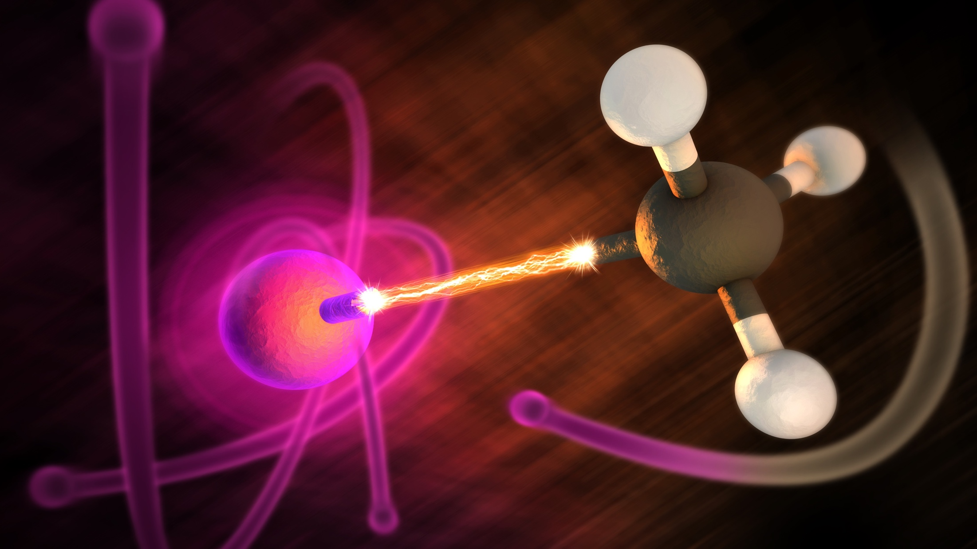



Electrons to Molecules
Goal
Focuses on the use of abundant and cheap electrons to convert small waste gases (e.g., CO₂, H₂O, CH₄, etc.) to make chemical bonds for energy storage and/or the synthesis of chemicals, fuels, and materials.
Hybrid Approaches to CO₂ Reduction and Creating the Electron Foundry
Reactive Carbon Capture and Conversion
Novel Electricity-Driven Processes for Industrial Manufacturing
Opportunities: Biocatalysis, Electrocatalysis, and Hybrid Electro-Bio Catalysis
Notes:
Talking Points
NREL is prepared to lead the research on this conversion of electricity and materials such as carbon dioxide and water into high-value chemical precursors.
Researchers are developing efficient, electricity-driven processes that transform these readily available and low-cost materials into reactive intermediates and coupling them with biological or catalytic processes to generate compounds that we use today to make plastics, fibers, and fuels.
Besides the conversion of carbon dioxide and water, NREL also will investigate the use of electricity-driven processes to convert other materials such as nitrogen to ammonia, transform fossil fuels and biomass into chemicals, deconstruct plastics for recycling and reuse, and refine ores to generate metals.

Slide 54

Circular Economy for Energy Materials
Concept
New concepts, approaches, and understanding for recovery and recycle, materials substitution, device/system design, and advanced manufacturing processes
Benefit
Mitigates limited supply issues
Reduces waste, promotes upcycling, increases efficiency and sustainability
Adds value to end-of-life products
Challenges
Providing substitutes for critical materials
Enabling separation, processing of heterogeneous wastes
Increasing life-cycle efficiency of embedded energy
Notes:
Picture: iStock-902206988
Talking Points
Circular Economy for Energy Materials focuses on reducing waste and preserving resources through the design of materials and products with reuse, recycling, and upcycling in mind from the start.
The days of taking, making, using, and disposing of materials are rapidly coming to a close. This linear economy is not only inefficient and unsustainable, but we will ultimately face resource limitations, which will make it impossible to maintain.
That’s why NREL is dedicating resources to research that will underpin a circular economy—designing clean energy technologies with reducing, reusing, and upcycling in mind for energy-relevant and energy-intensive materials, processes, and technologies. This effort will help mitigate supply issues, promote upcycling, reduce waste, and add value to materials at end of life.
The Challenge
Many renewable energy and electronics technologies are highly complex and require high-quality materials as well as critical and rare metals that will become progressively scarcer with increased deployment or disruptions to the supply chain. Complex products are difficult to deconstruct at end of life, because the products are not designed to be disassembled and the recycling infrastructure does not have the processes and technologies needed to reclaim many of the components and highvalue minerals—so all or part of these devices end up in landfills as waste.
Adding to the problem are plastics and composites manufacturing technologies. According to experts, plastics and composites are on track to produce approximately 12 billion metric tons of plastics-based materials by 2050, the vast majority of which will accumulate in landfills or, worse, in the environment. Based on current and future projected plastics input to the oceans, there is predicted to be more plastics than fish by mass by 2050.
As renewable energy generation and storage become central components of a sustainable and prosperous economy, novel materials and manufacturing strategies will be required to ensure that these technologies are not contributing to the problem at end of life.

Slide 55
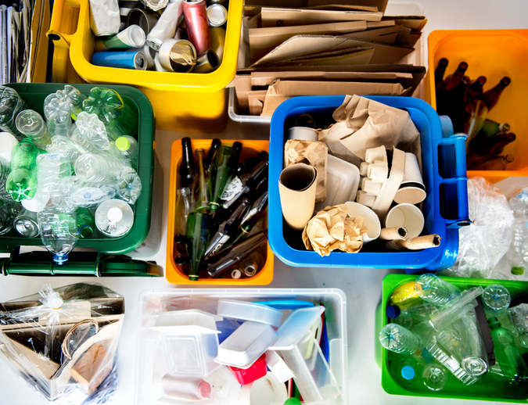



Circular Economy for Energy Materials
in
Goal
Focuses on research that establishes the foundational knowledge and technology for design, reduce, reuse, or recycle to create a circular economy for energy-relevant and energy-intensive materials, processes, and technologies.
Circularity for Polymers and Composites
Advanced Energy Materials and
Technologies
Future Adaptive Materials for Energy Systems
Opportunities: Analysis and Modeling, Materials Processing, Devices and Systems, Reliability and Lifetime
Notes:
Picture: iStock 664980412
Talking Points How do we get there?
Plastics, composites, and polymers: We aim to develop the science and technologies necessary to make the recycling, upcycling, and reuse of these materials ubiquitous in developed and developing economies alike. We must:
Design and develop science, concepts, and technologies for reclamation, cost-effective recycling, and upcycling of existing composites and plastics, as well as next-generation feedstocks, composites, and plastics (including bio-based systems).
Demonstrate value added to plastics/composites waste, decreased waste and environmental impact, and advanced manufacturing.
Advanced energy materials/technologies: Improved clean energy technology product design and a more effective recycling and upcycling system would allow recovered materials to be of higher quality. We must:
Assess emerging critical materials and better understand when they will become critical if deployed at scale as well as develop substitution technologies that are in abundance with similar or better properties and minimal negative economic, human health, and environmental impact.
Determine how we can design for modularity, upgrades, and deconstruction as well as how to create a longer-lasting product by designing it for upgrades and reparability.
Explore the design of products to allow for use of lower purity materials (recovered materials), as well as the possible trade-offs.
Future adaptive materials for energy systems: We aim to learn from natural systems to develop energy technologies that are cheaper, lighter weight, more flexible, more resilient, and more adaptable to their environment. We must:
Design and develop new materials, innovative concepts, and next-generation technologies for sustainable energy generation, storage, and use.
Develop new tools, data, analytics, and science for lifetime prediction of new, recyclable, or upcycled materials, components, and systems.
Establish new concepts and processes for the upcycling, reclamation, reprocessing, and remanufacture of elements, materials, components, devices, and systems.
Provide advanced science and technology that enables the design and development of recyclable plastics, polymers, and composites.
Integrate analytical frameworks, tools, and modeling for decision making and benchmarking spanning materials discovery to deployment of circular sustainable materials, devices, and systems.

Slide 56
Thank you
This work was authored by the National Renewable Energy Laboratory, operated by Alliance for Sustainable Energy, LLC, for the U.S. Department of Energy (DOE) under Contract No. DE-AC36-08GO28308. The views expressed in the article do not necessarily represent the views of the DOE or the U.S. Government. The U.S. Government retains and the publisher, by accepting the article for publication, acknowledges that the U.S. Government retains a nonexclusive, paid-up, irrevocable, worldwide license to publish or reproduce the published form of this work, or allow others to do so, for U.S. Government purposes.
Notes:
Picture, 60817.jpg, 1/16/2020, Bill Kindred, (Photo by Werner Slocum)
*Author: Insert the words “In part” if your research is funded by entities outside of DOE. The wording would say, This work was authored in part by the Alliance . . .
**Author: insert applicable Department of Energy office and program office, e.g., U.S. Department of Energy Office of Science or U.S. Department of Energy Office of Energy Efficiency and Renewable Energy Solar Energy Technologies Office (spell out full office names; do not use initialisms/acronyms)].

